Slide 1
Chapter 11: GUI Programming: Deitel Book
Additional Examples

Slide 2
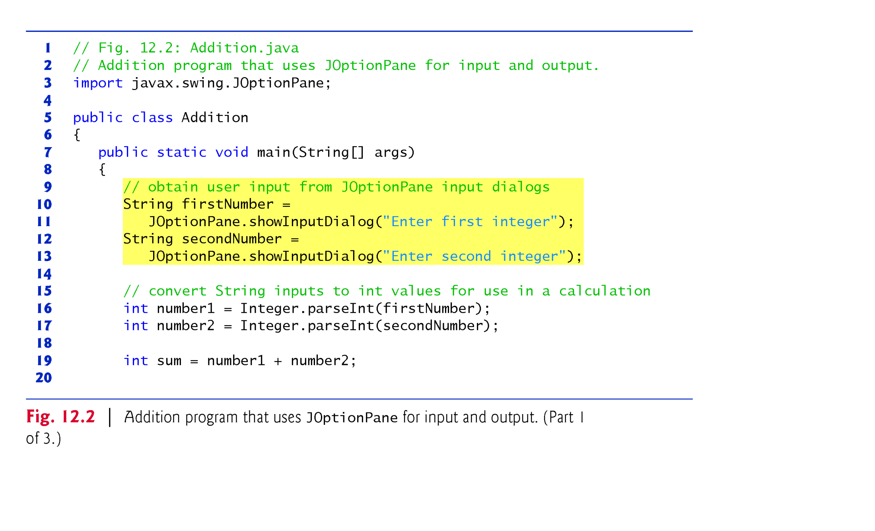
Example 1: Simple Input/Output with JOptionPane

Slide 3
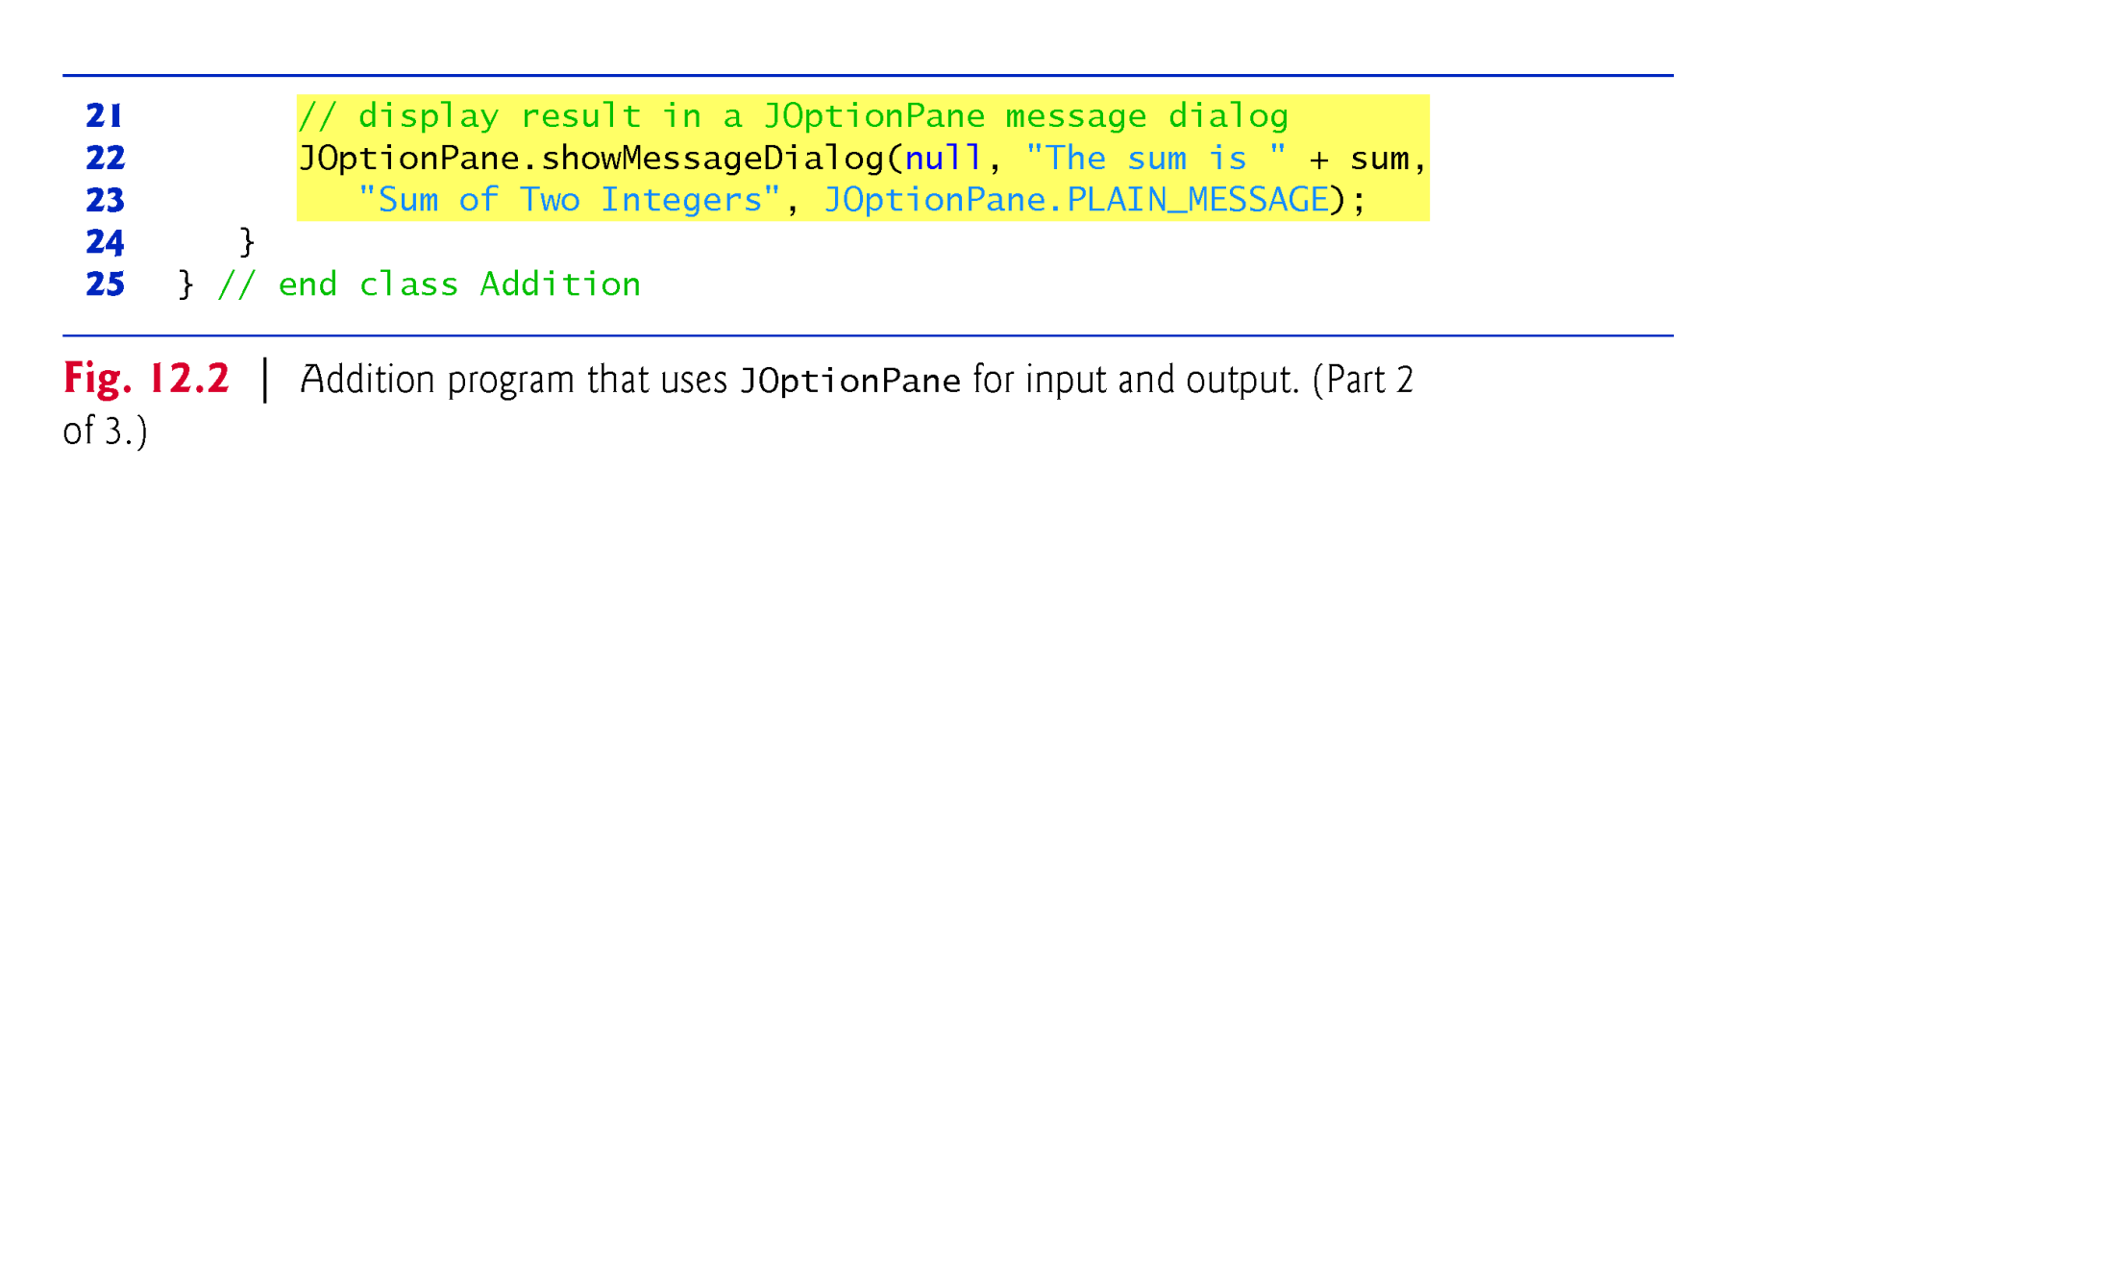
Example 1: Simple Input/output with JOptionPane

Slide 4
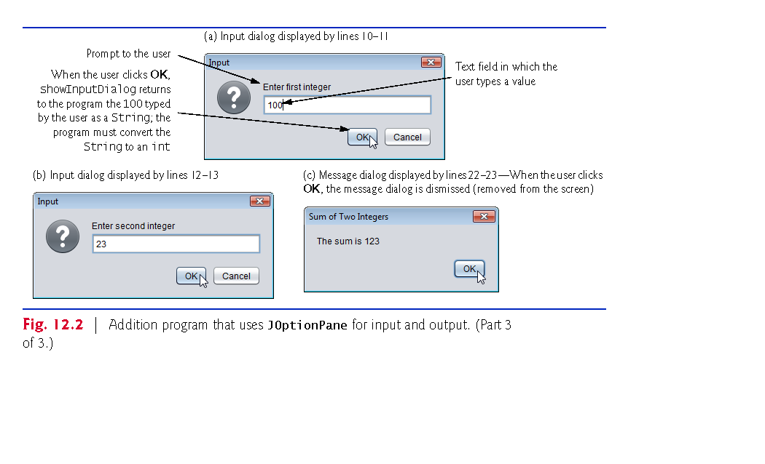
Example 1: Simple Input/output with JOptionPane

Slide 5
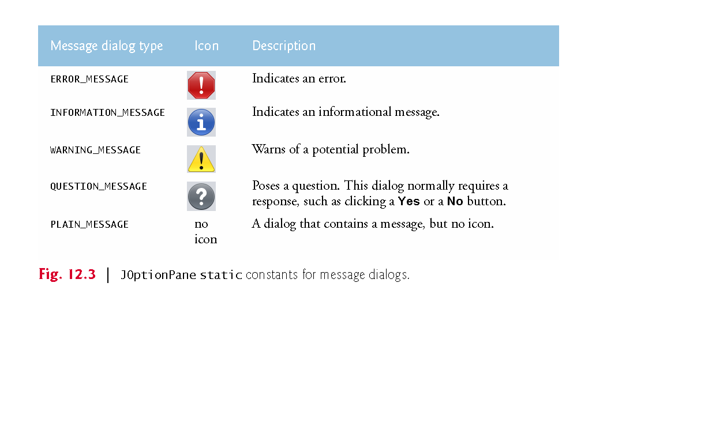
Message Dialog Constants of JOptionPane Class

Slide 6
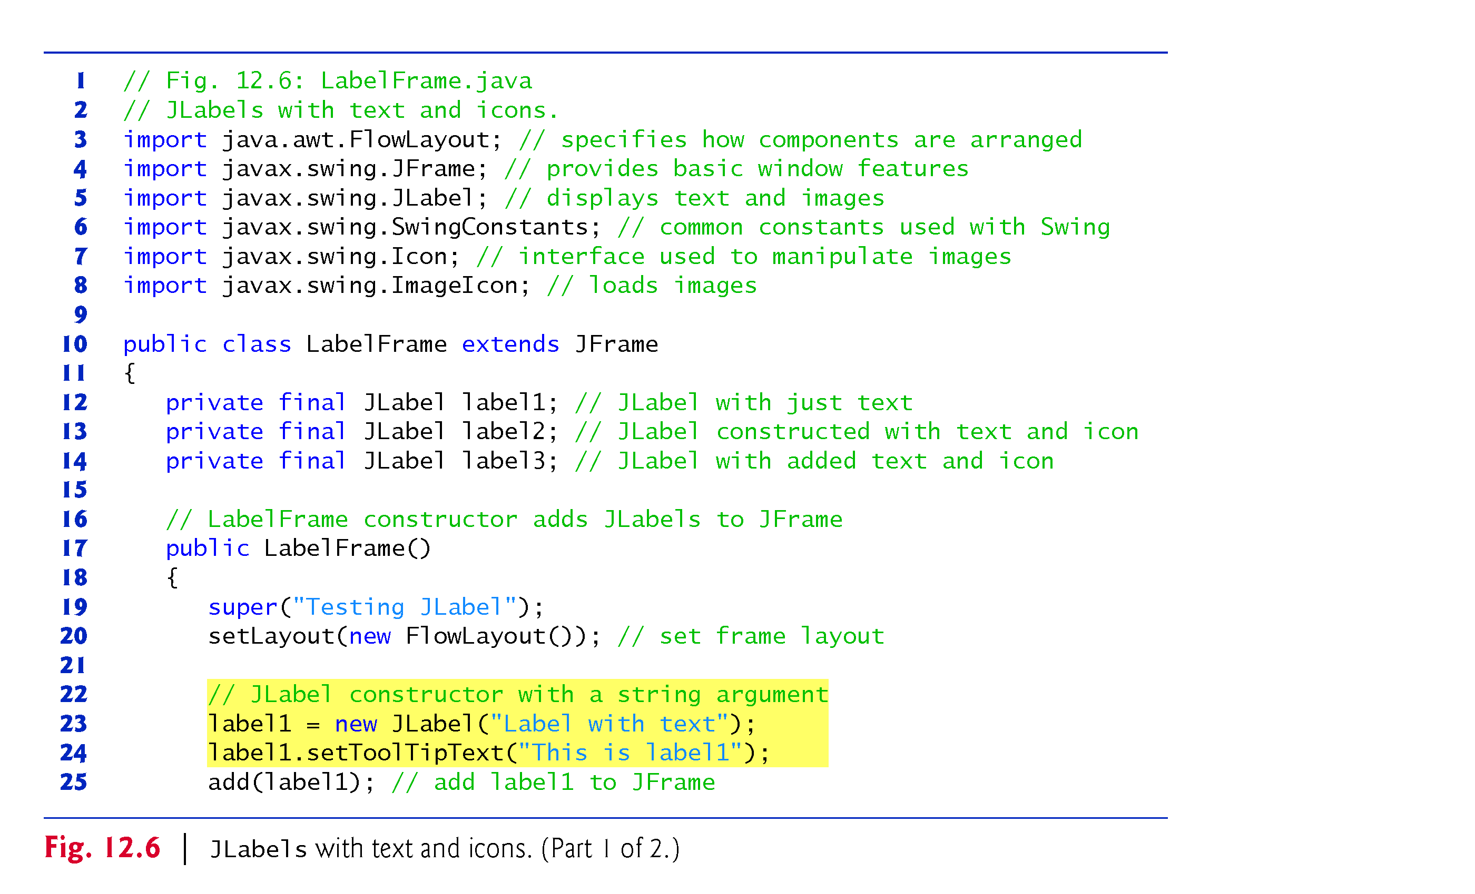
Displaying Text and Images in a Window
L12-14: Has-a relation
L19: Jframe (string title); // title of the window on screen
L20:void setLayout (LayoutManager manager)
L23: Jlabel (string text)
L24:public void setToolTipText(string text)

Slide 7
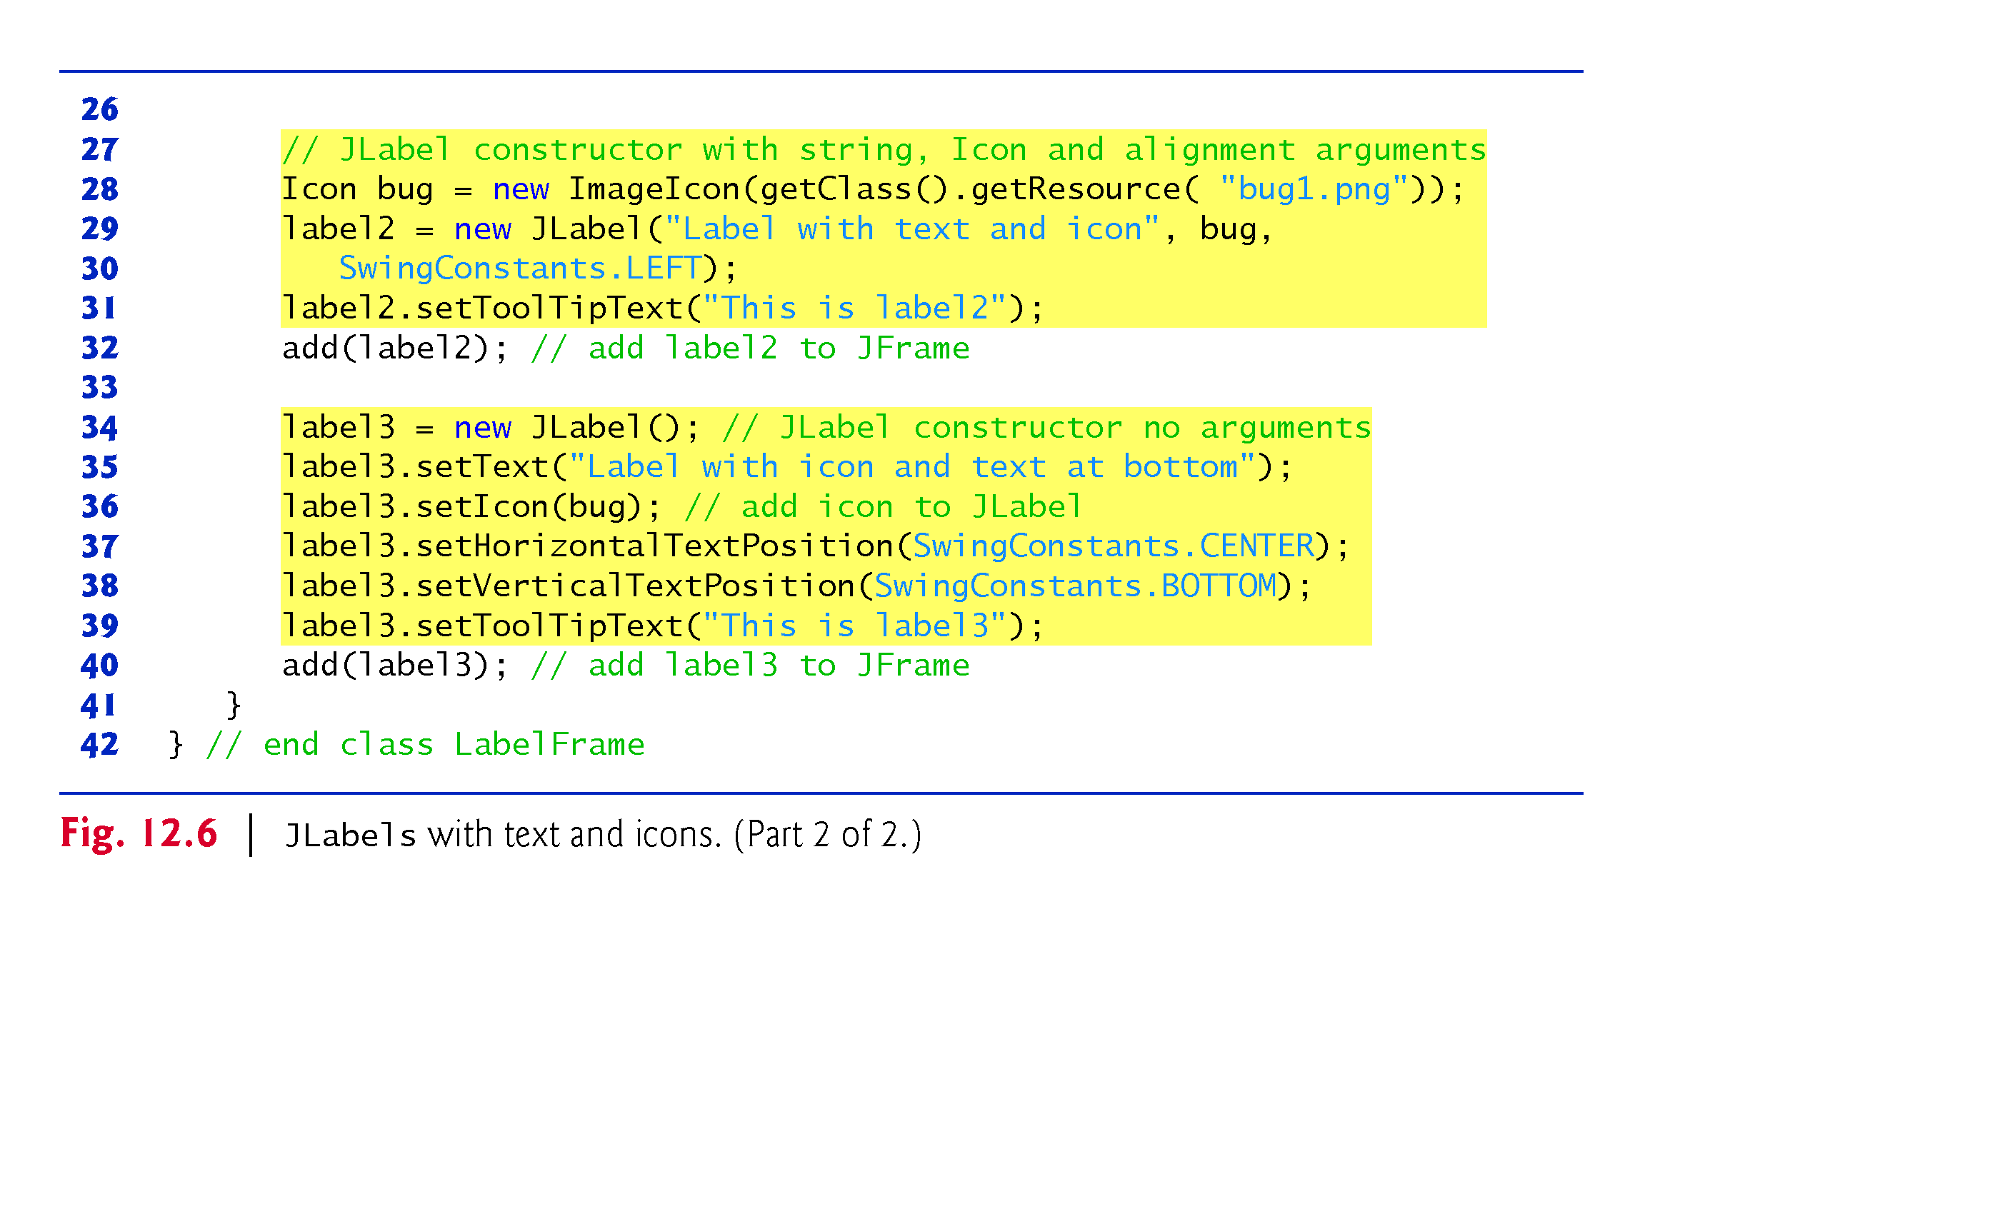
L28:Class getClass();
It has public URL getResouce(String name)
public ImageIcon(URL location);
ImageIcon implements Icon
Public interface Icon; // small picture to decorate GUI components
L29: public JLabel (String text, Icon icon, int horizontalAlignment);
horizontalAlignmnet : LEFT/CENTER/
RIGHT/ LEADING/TRAILING
SwingConstants is an interface related to position and orient components on screen.
L37-38: position of text relative to image

Slide 8
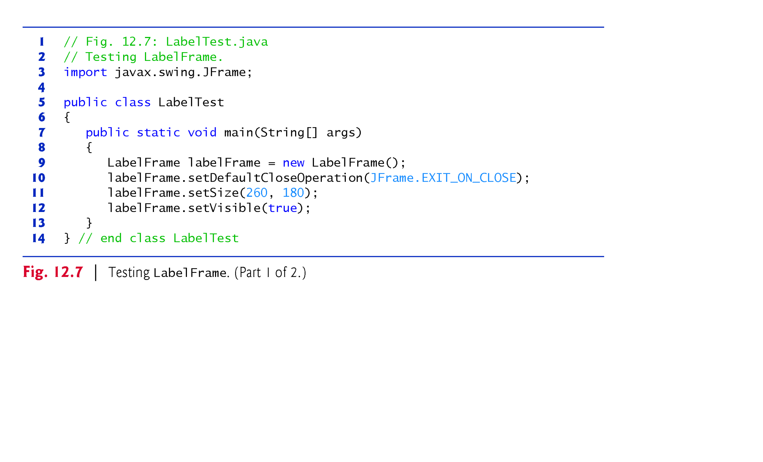
Line 10-12: The three methods are inherited from the built-in Jframe class

Slide 9
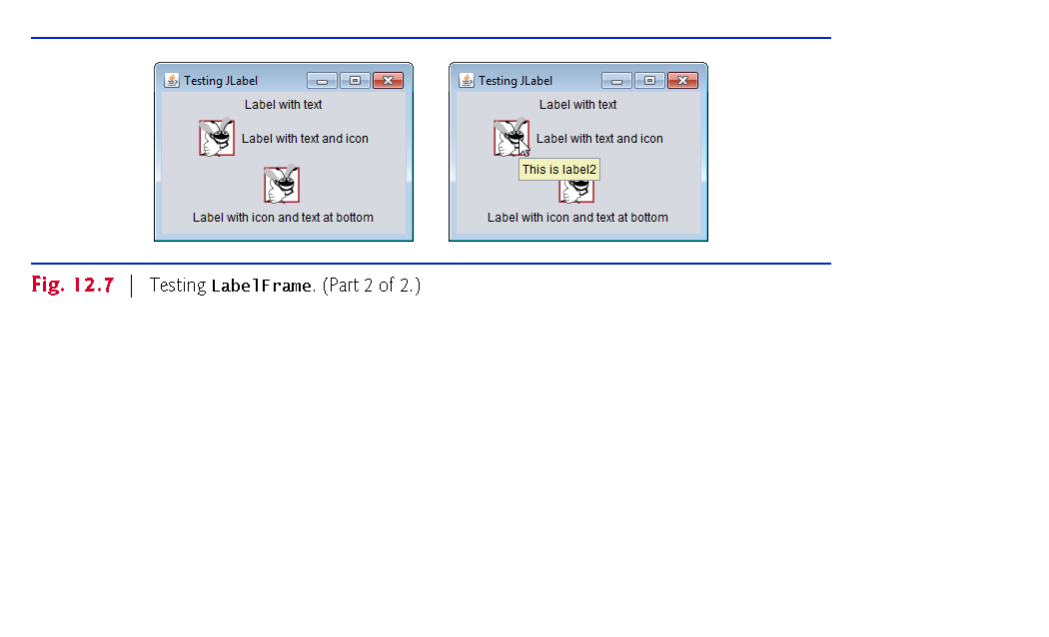
Three labels are displayed in the window (Jframe).
JLabel with only text
JLable with Icon(left) and text
JLabel with icon and text (bottom)

Slide 10
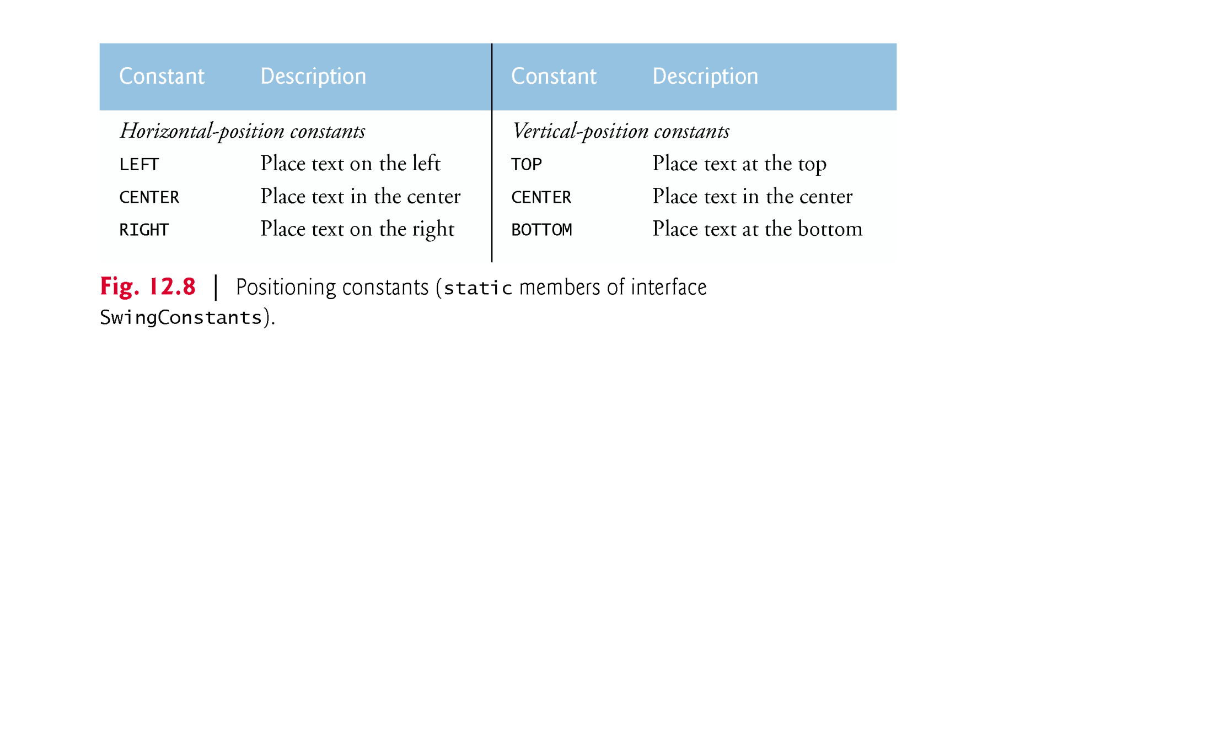
SwingConstants Interface

Slide 11
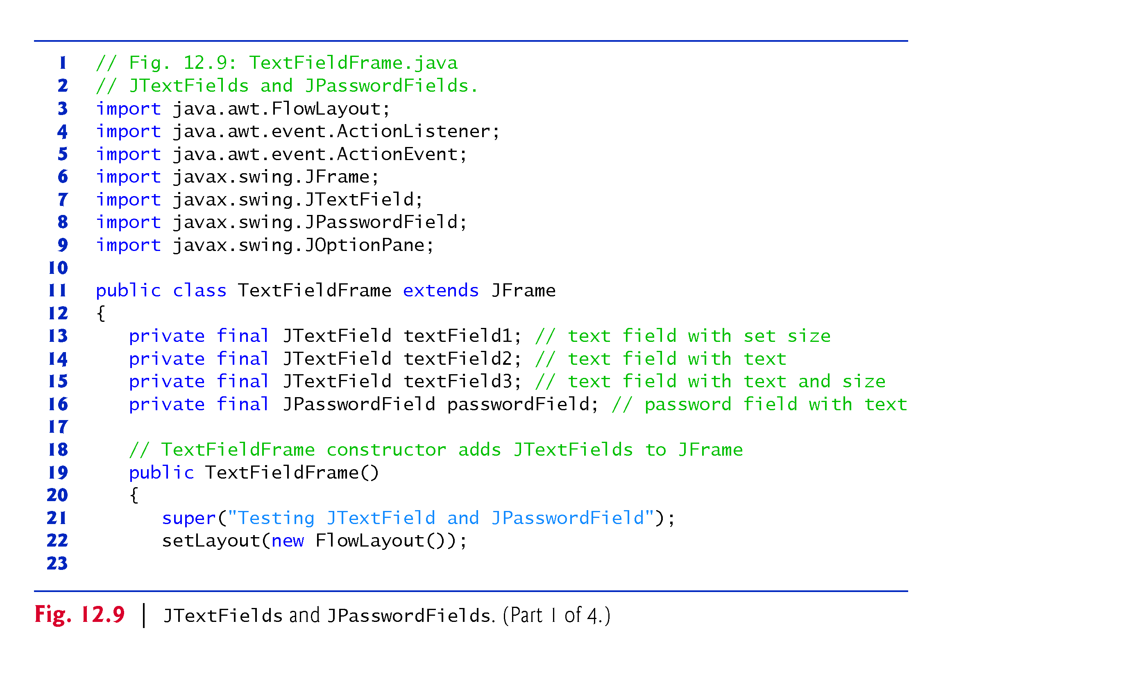
Example 3: TextField and PasswordField GUIs
How a program perform a task in response to an event generated by GUI components ?

Slide 12
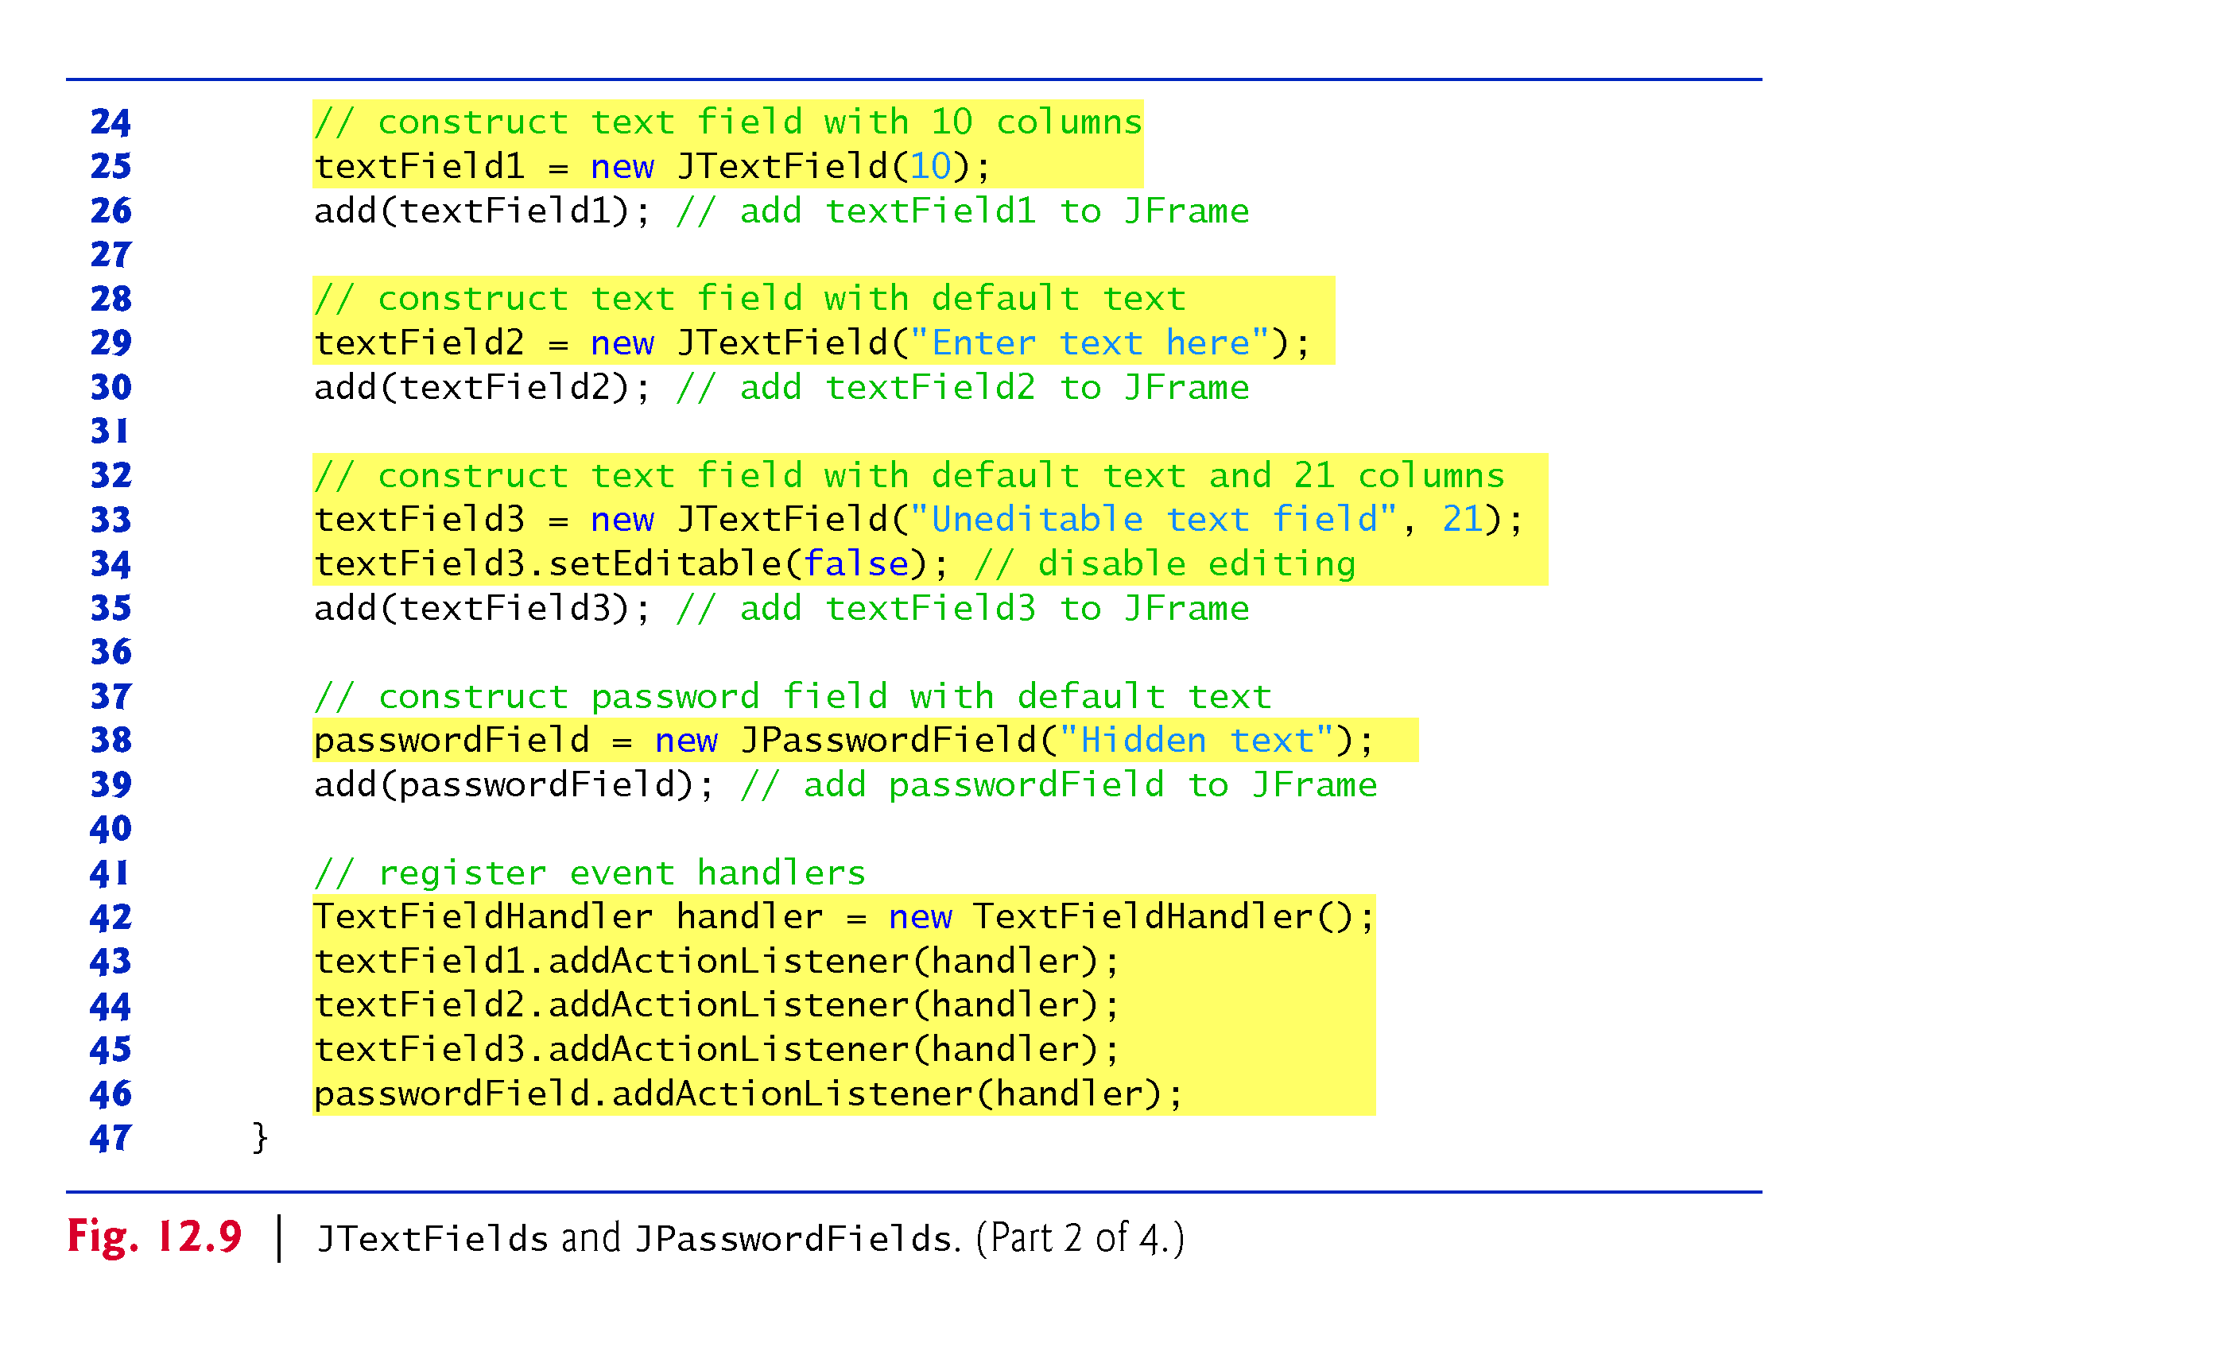

Slide 13
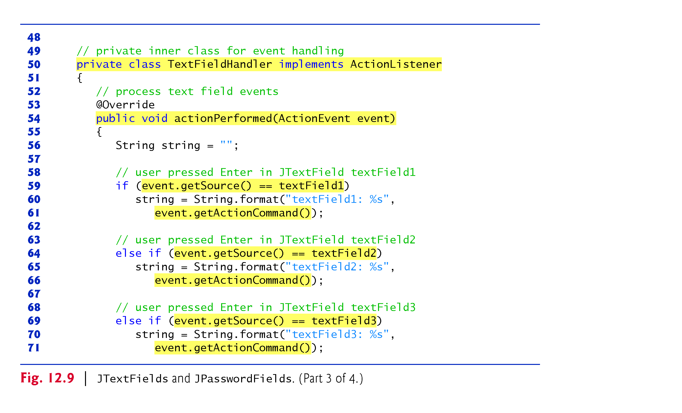
Line 54: This is the only method available in the ActionListner interface (java.awt.event package )

Slide 14
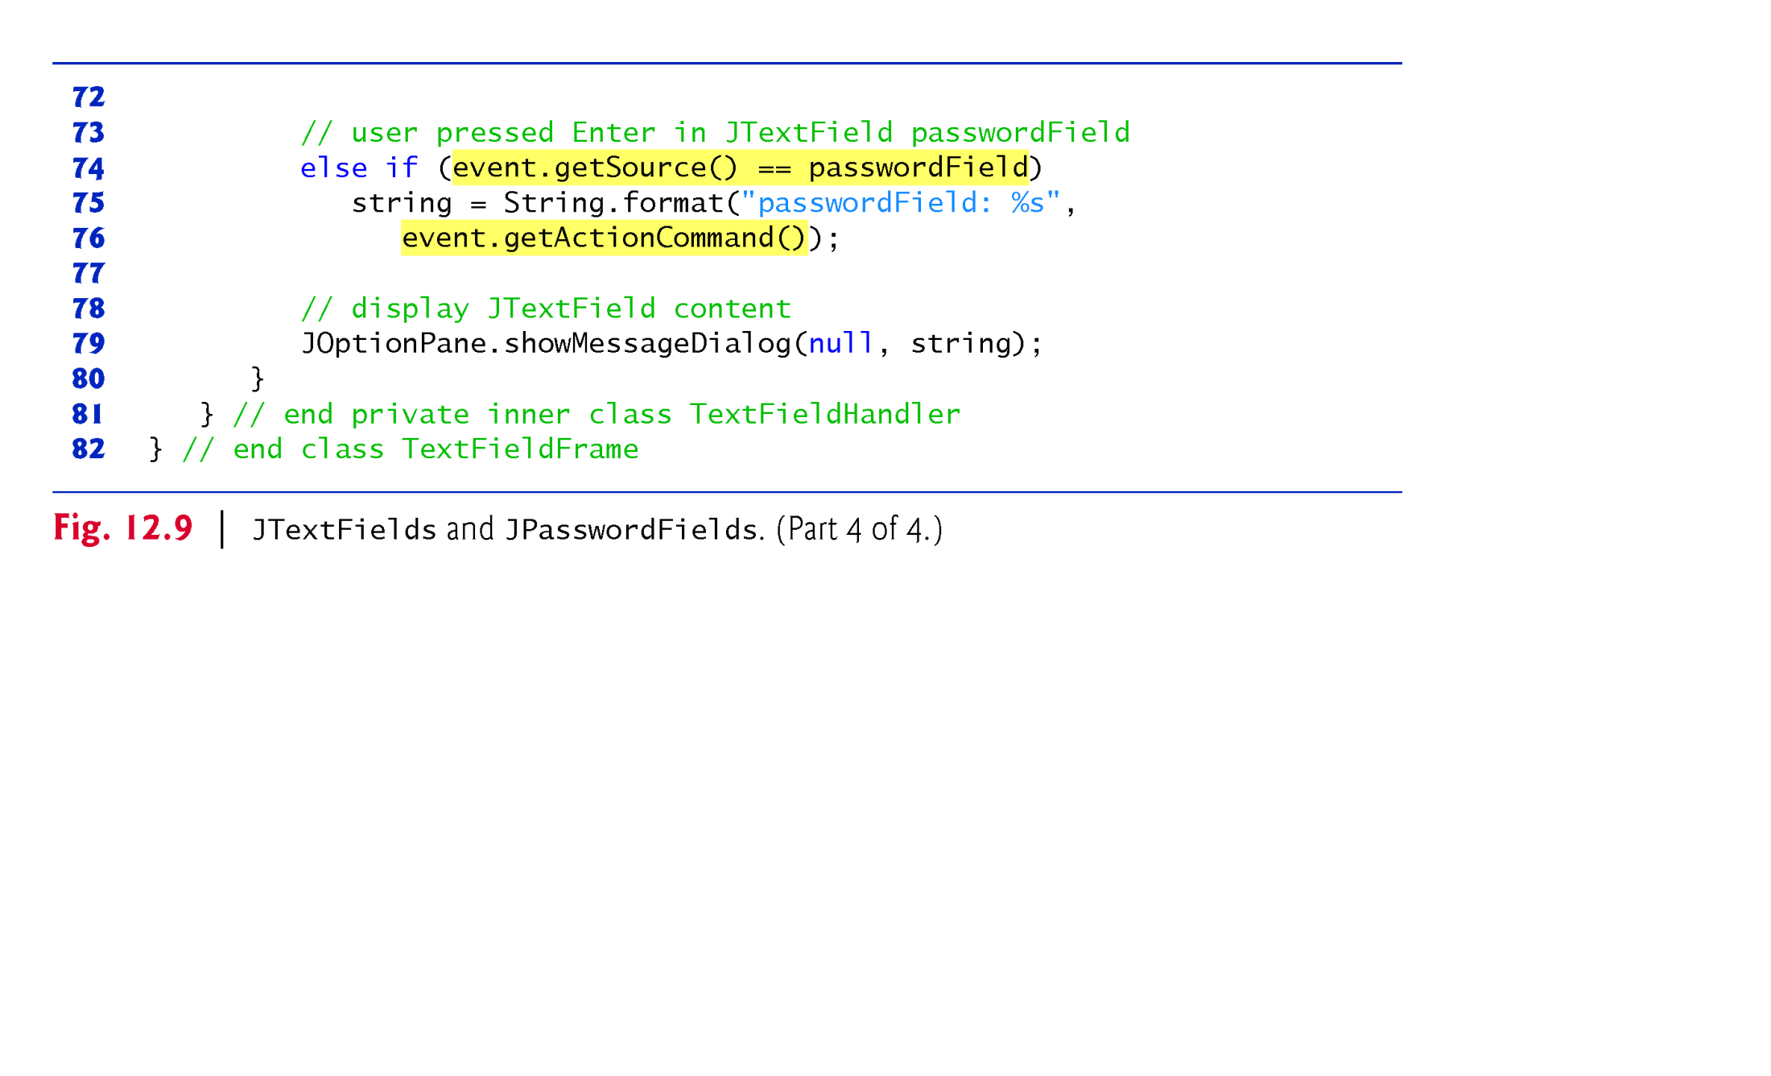
Line 50-81: Event handler implemented as an inner class of TextFieldFrame class
The event listener class of an event must implement the appropriate event listener interface
If we forget to register an event handler object for a particular GUI component’s event type , events of that type will be ignored.

Slide 15
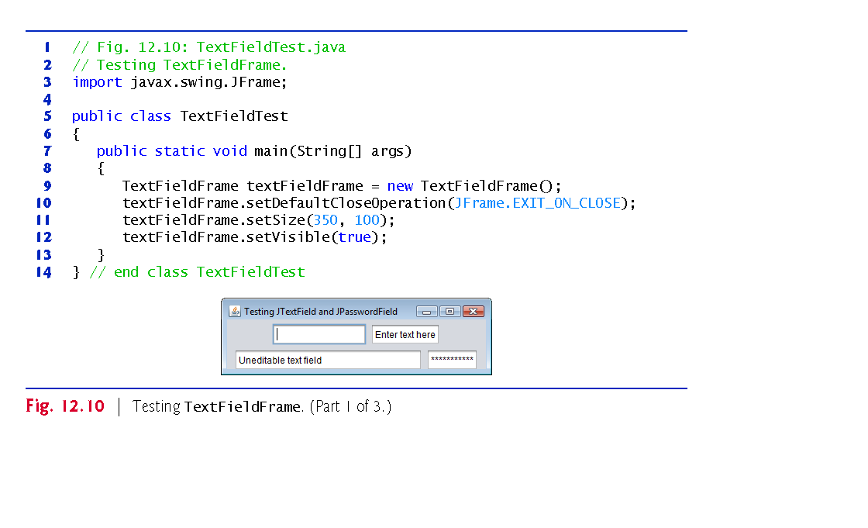

Slide 16
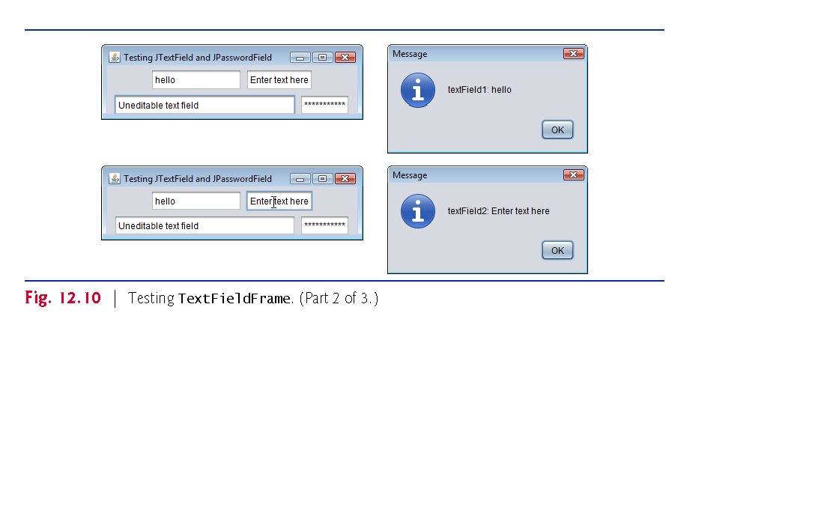

Slide 17
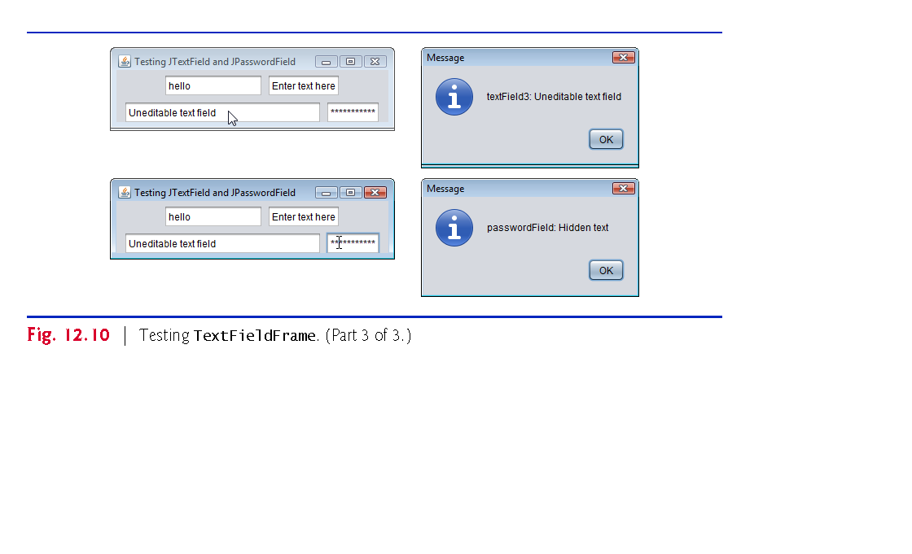

Slide 18
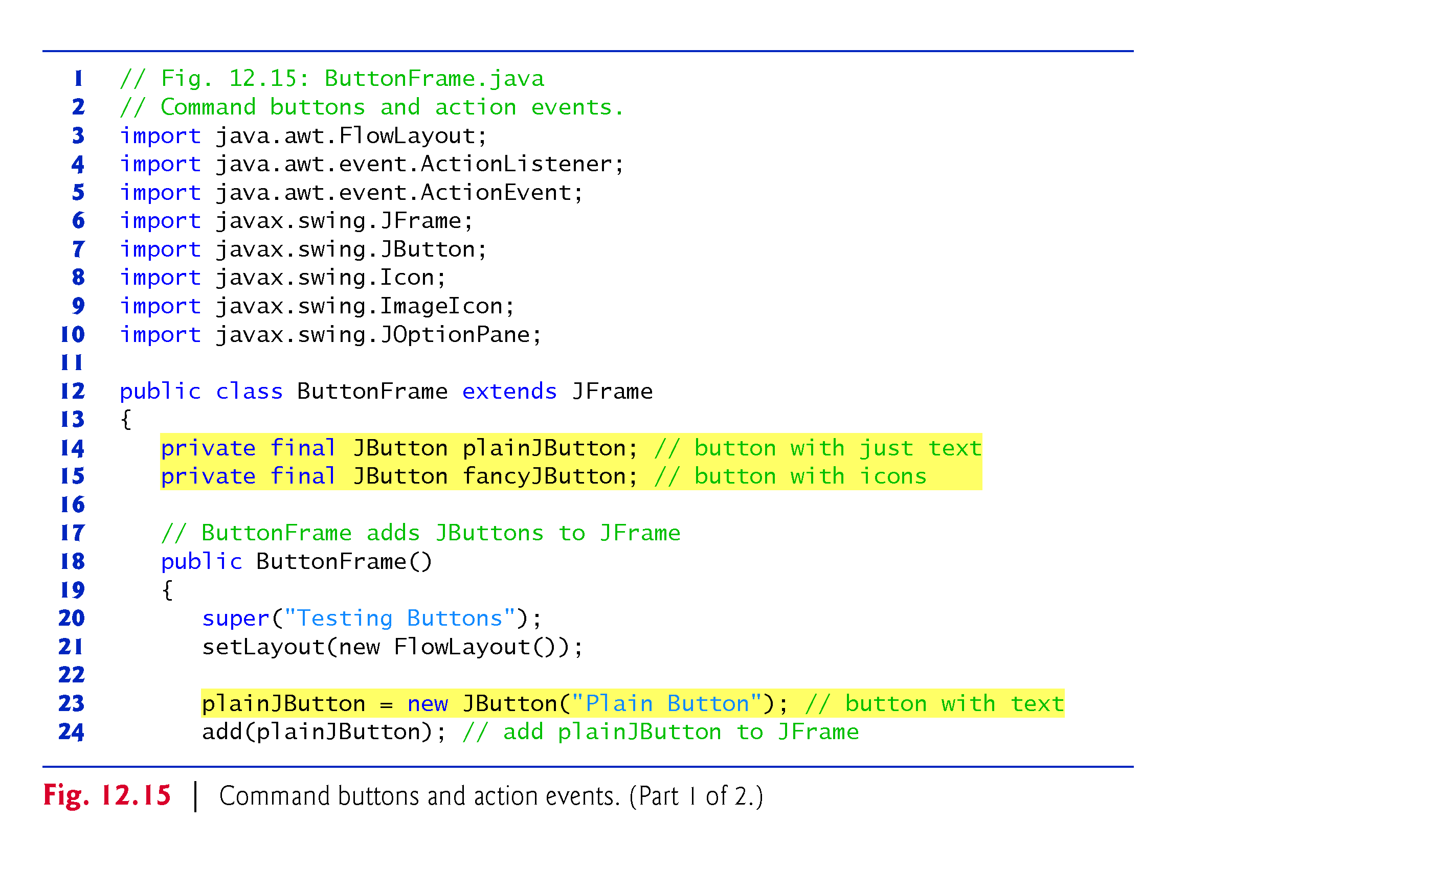
Example 4: JButton GUI component cont
Line 23: button display text label

Slide 19
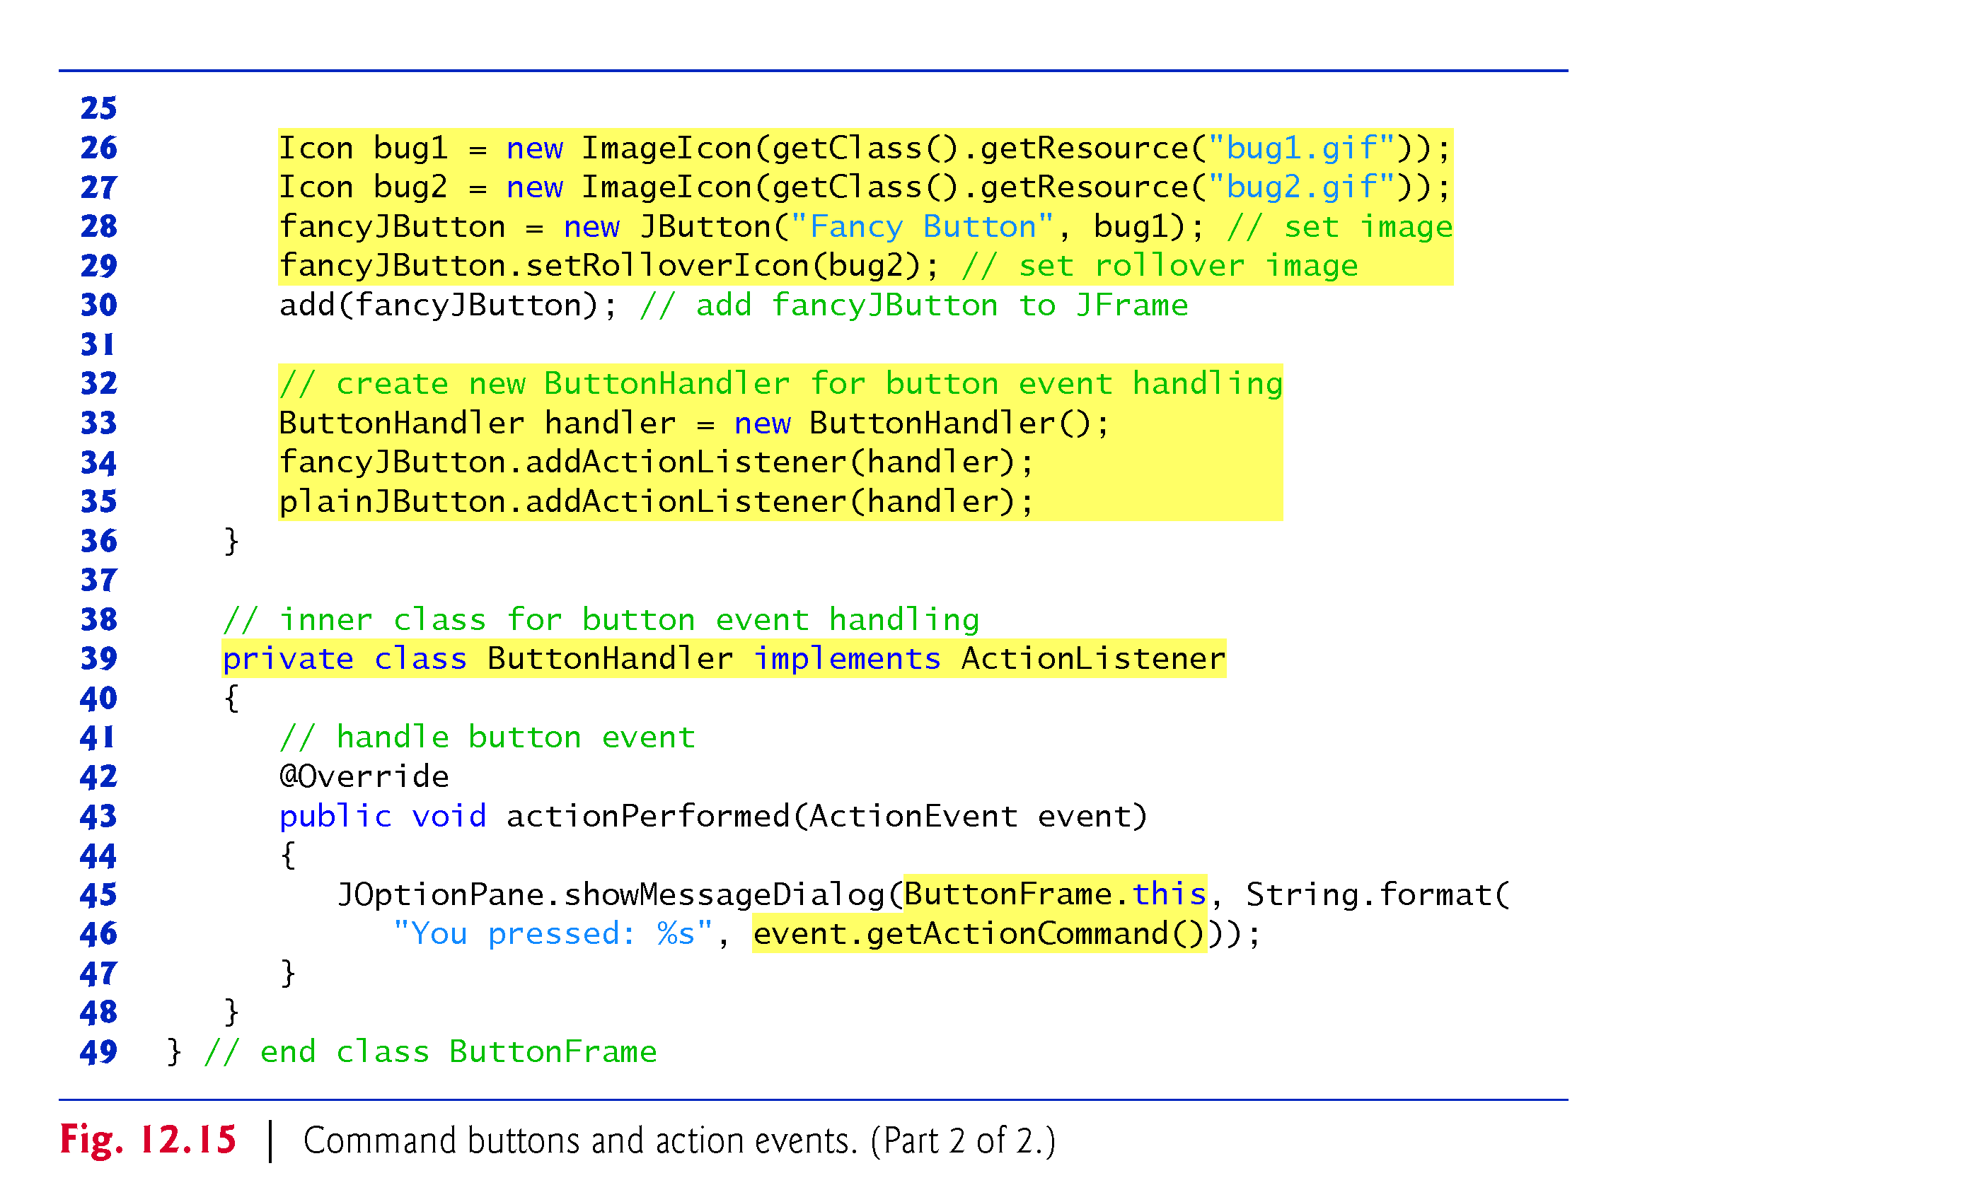
L28: button display text
label and icon
L 29: icon to be displayed when we put mouse over button
L43: this is the only method in ActionListner Interface (java.awt.event)
.
L 43: like JTextField, JButton generates ActionEvent.
L 45: inner class access the “This” reference of outer class object

Slide 20
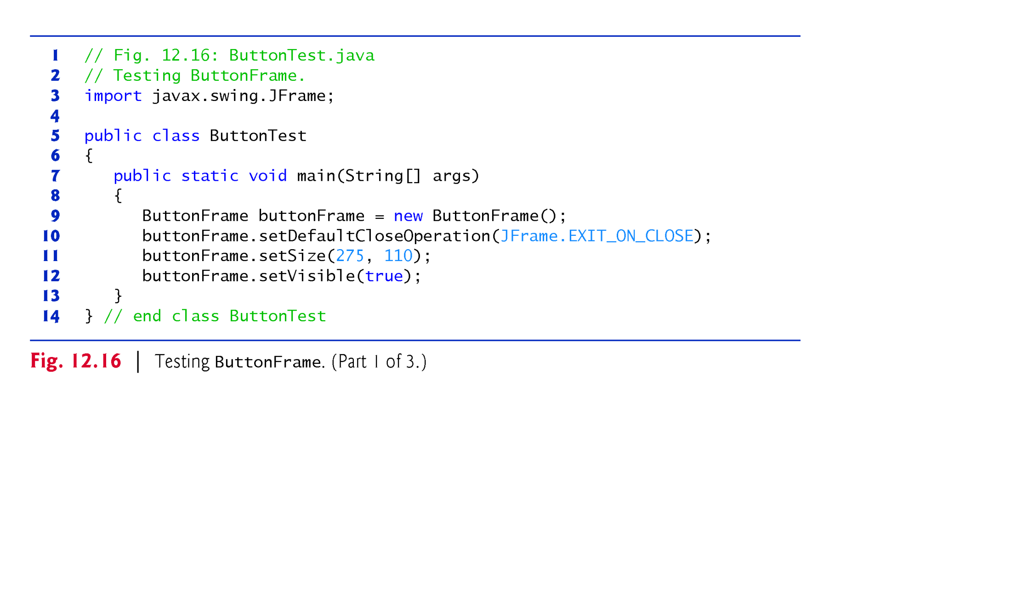
L 43 (Fig.12.5): like JTextField, JButton generates ActionEvent.
L 45 (Fig.12,5): inner class access the “this” reference of an object of outer class
If we use “this” key word in the method of an inner class , it refers to the current object of an inner class being manipulated
Hence, in the inner class method, to use the “this” reference of the current object of outer class , we use outer class name and dot operator like ButtonFrame.this.

Slide 21
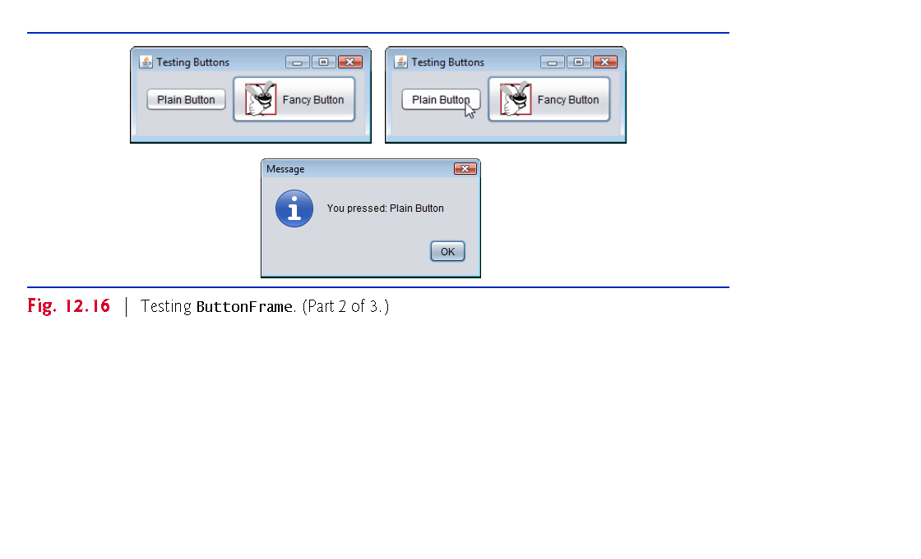
Line 29 (Fig.12.15) : rollover Icon is displayed.
setRolloverIcon() method of the JButton class is inherited from the AbstractButton class.
AbstractButton class supports displays both text and image, all of its subclasses display text and image

Slide 22
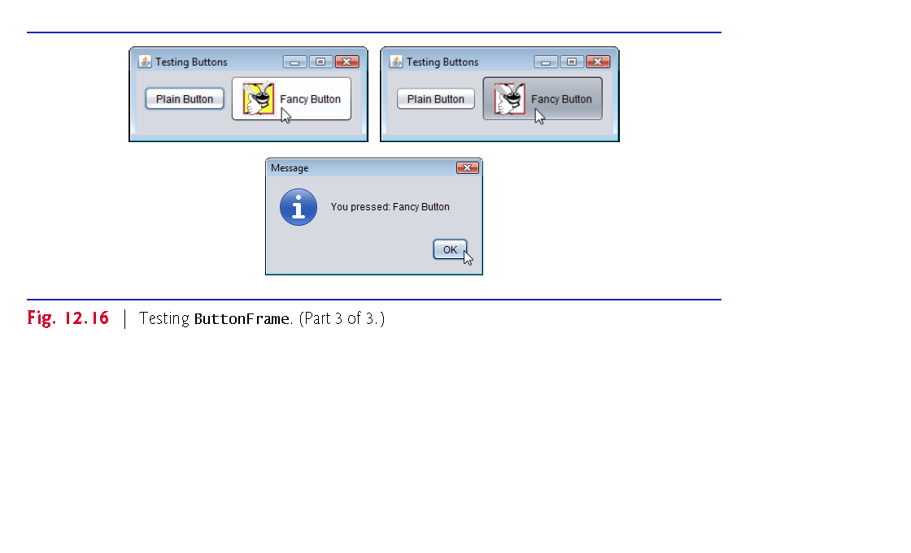
Line 29(Fig.12.15) : Rollover Icon provide visual feedback indicating that an action will occur when a Jbutton is clicked.

Slide 23
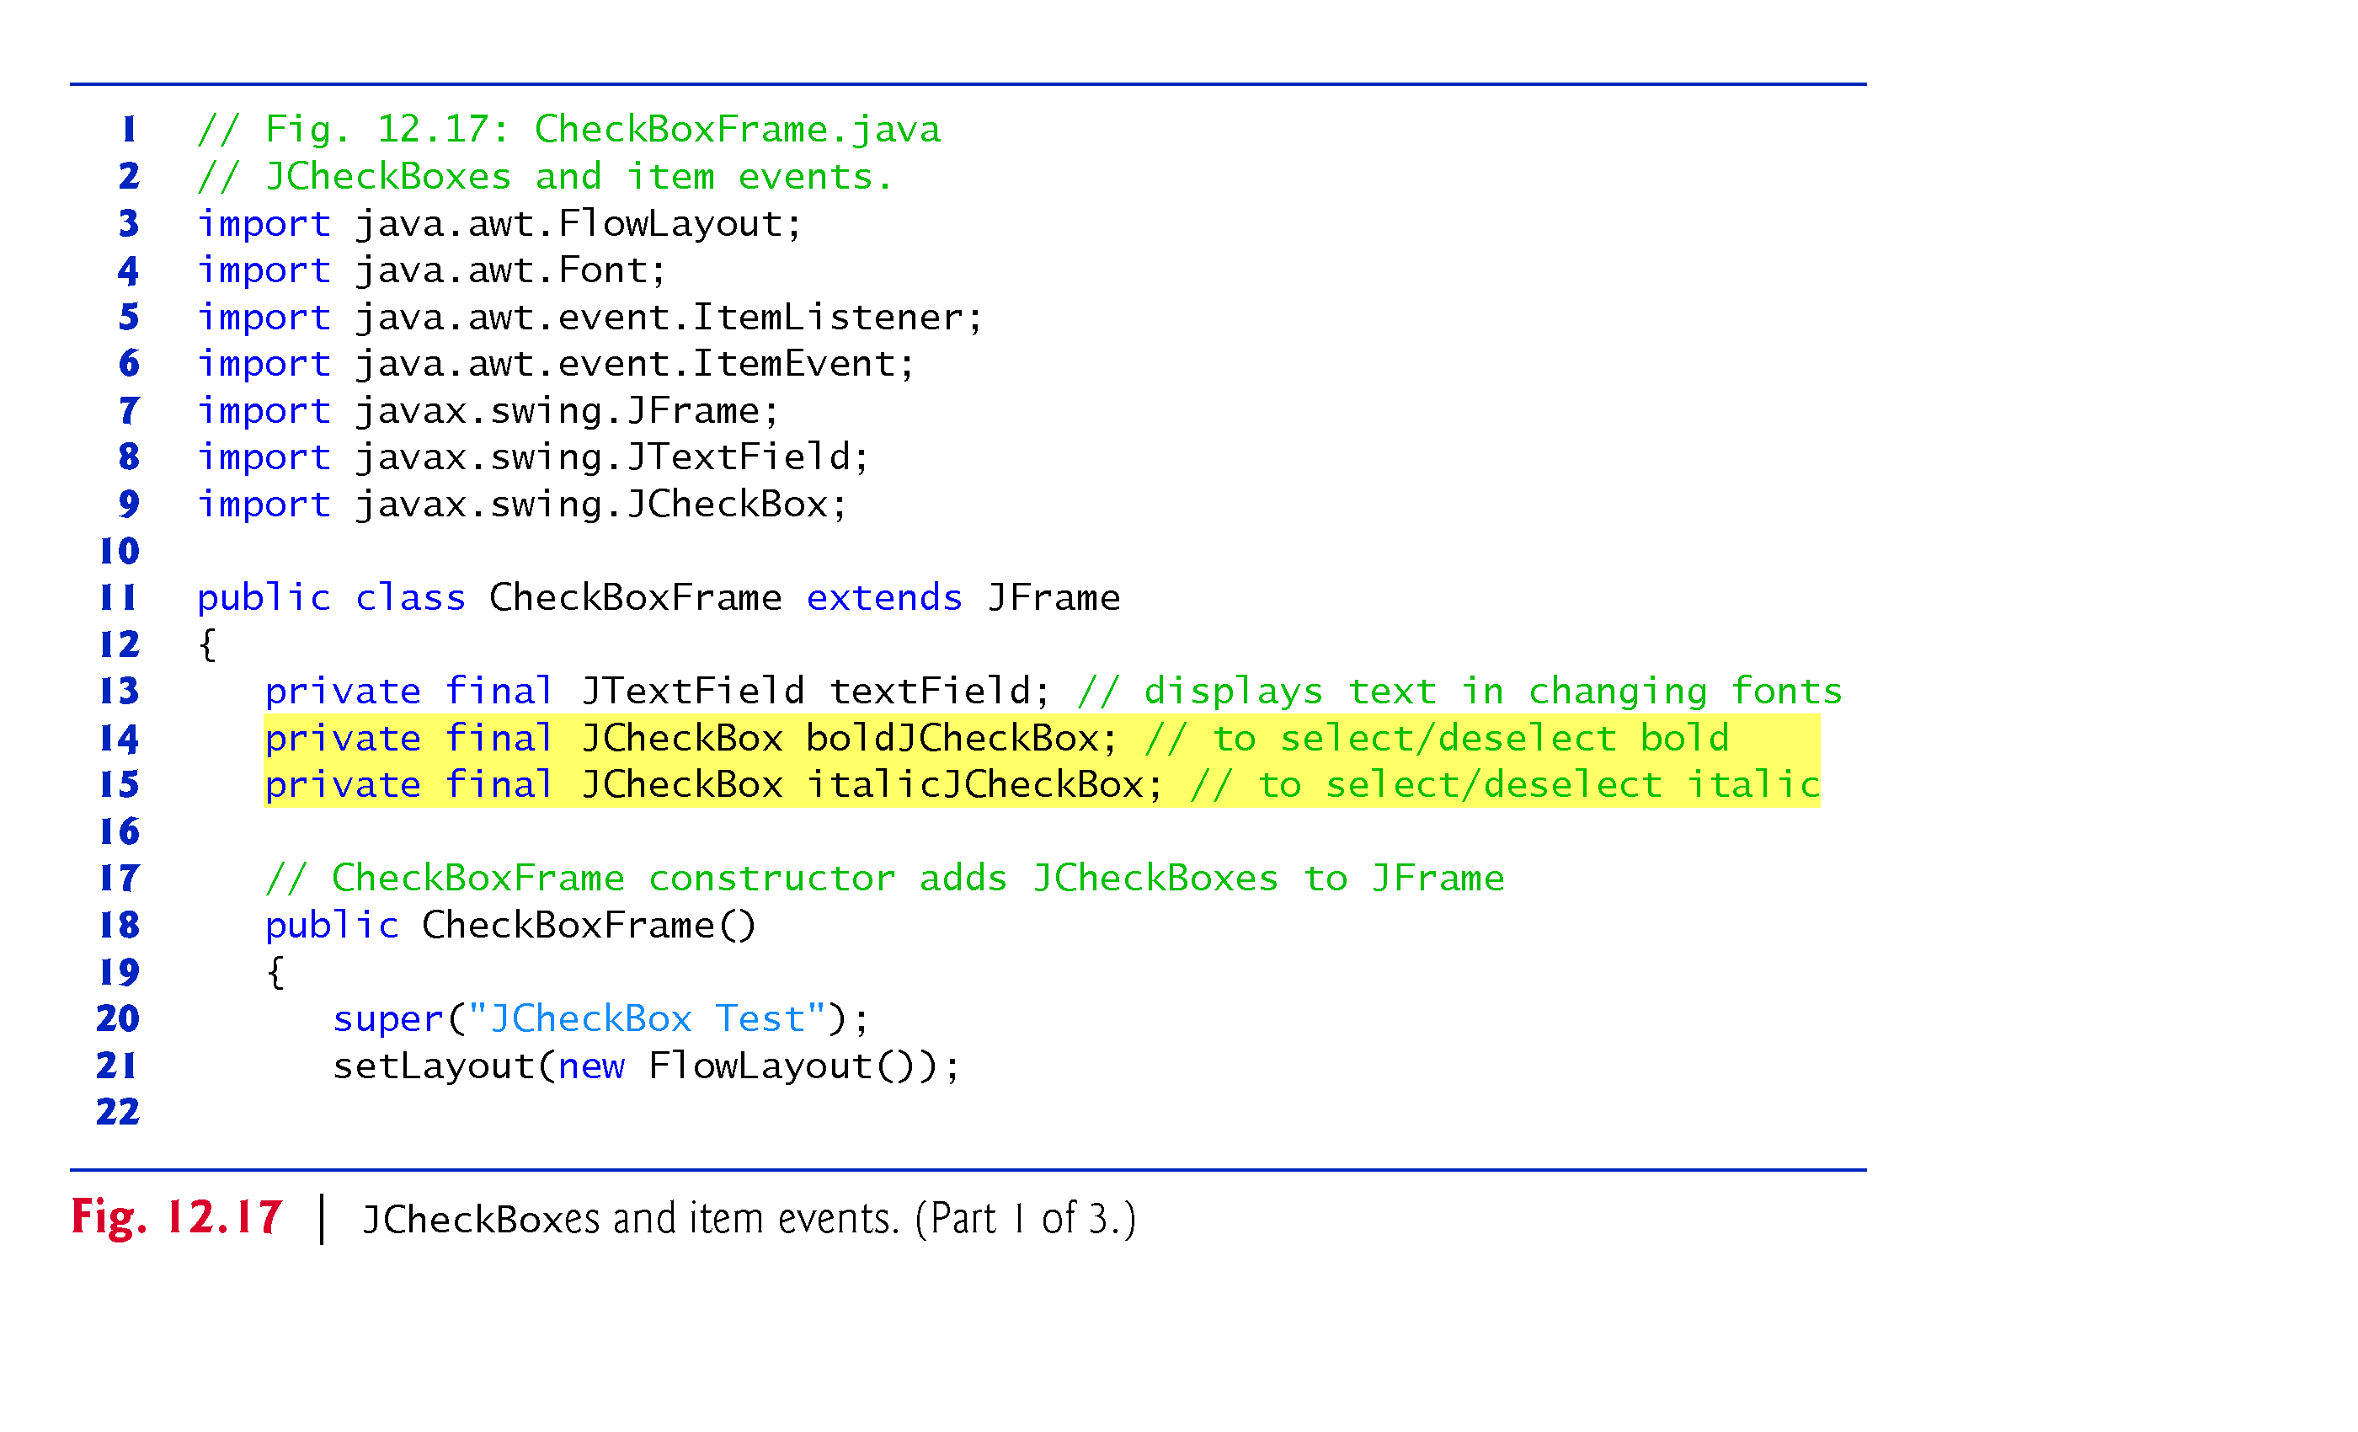
Example 5 : JCheckBox: to change font style of text
Font of text: plain/bold(off/on)
Font of text: plain/italic(off/on)
Line 4: Font class
Line 5-6: type of generated event class
Line 8: to display text

Slide 24
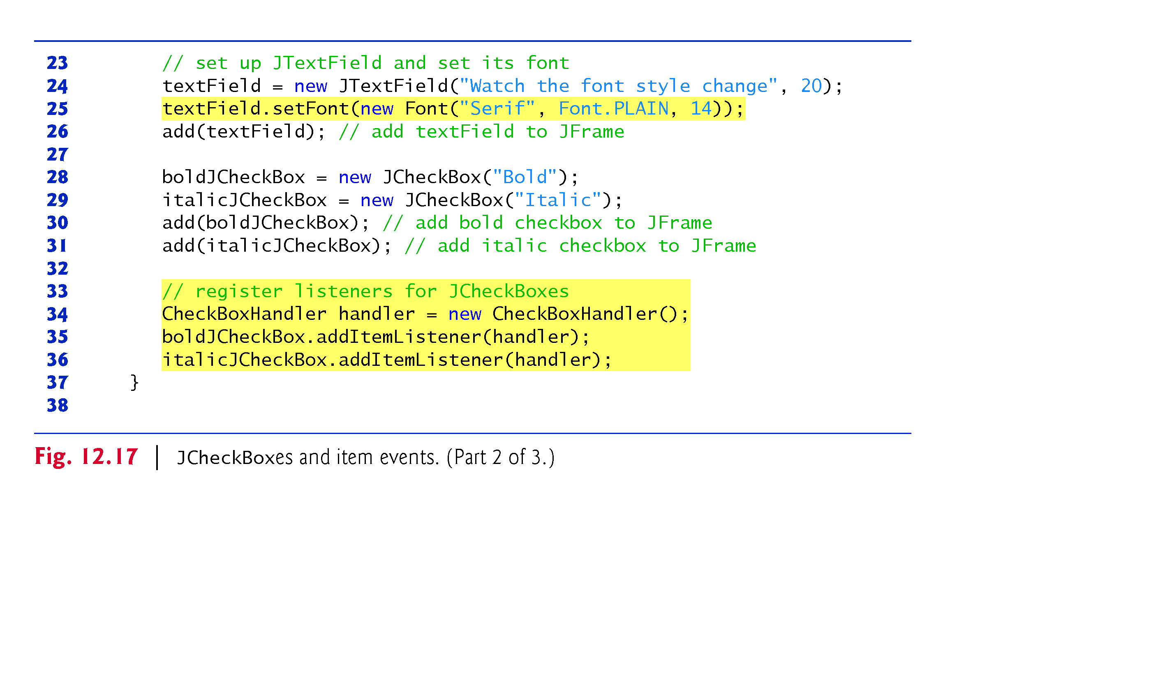
Example 5 : JCheckBox: to change font style of text
Line 25: JTextField inherits setFont() indirectly from Component

Slide 25
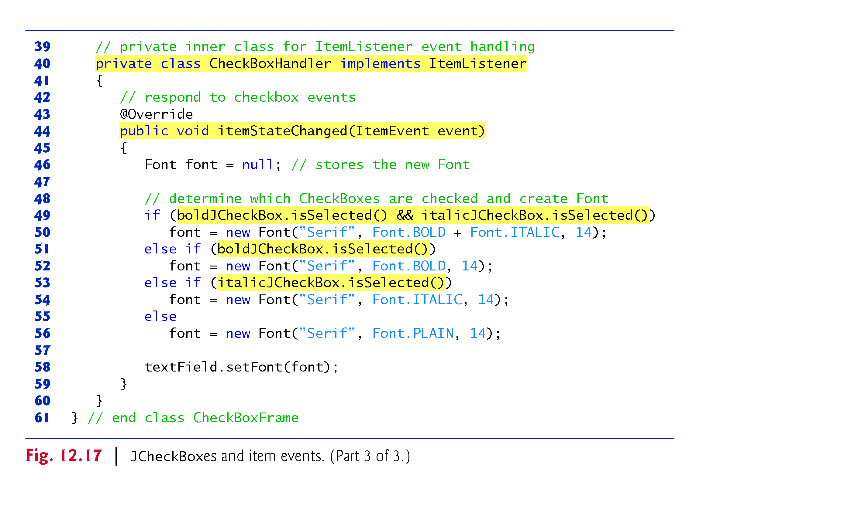
Line 44: this is the only method in ItemListner interface(java.awt.event)
Line 49: isSelected ()
returns true if selected
Line 49: method of inner class access member fields of our class
No explicit reference to access them
Source event selection is omitted in this code.

Slide 26
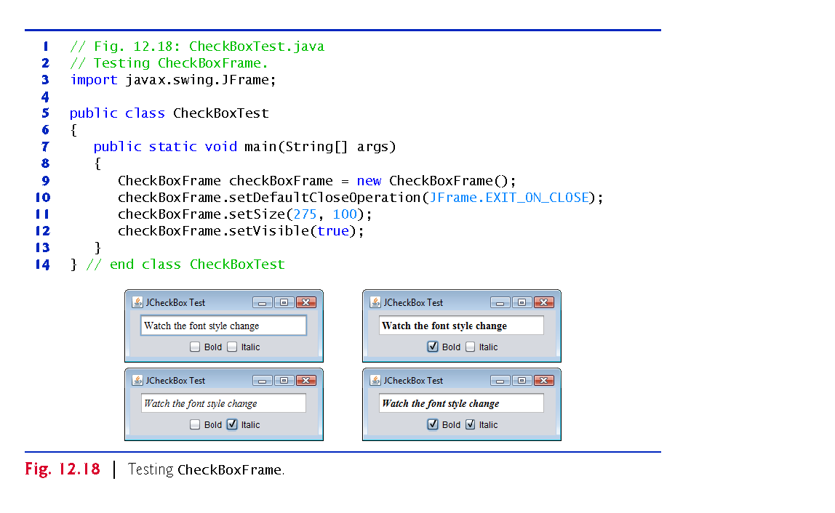
Example 5 : JCheckBox: to change font style of text

Slide 27
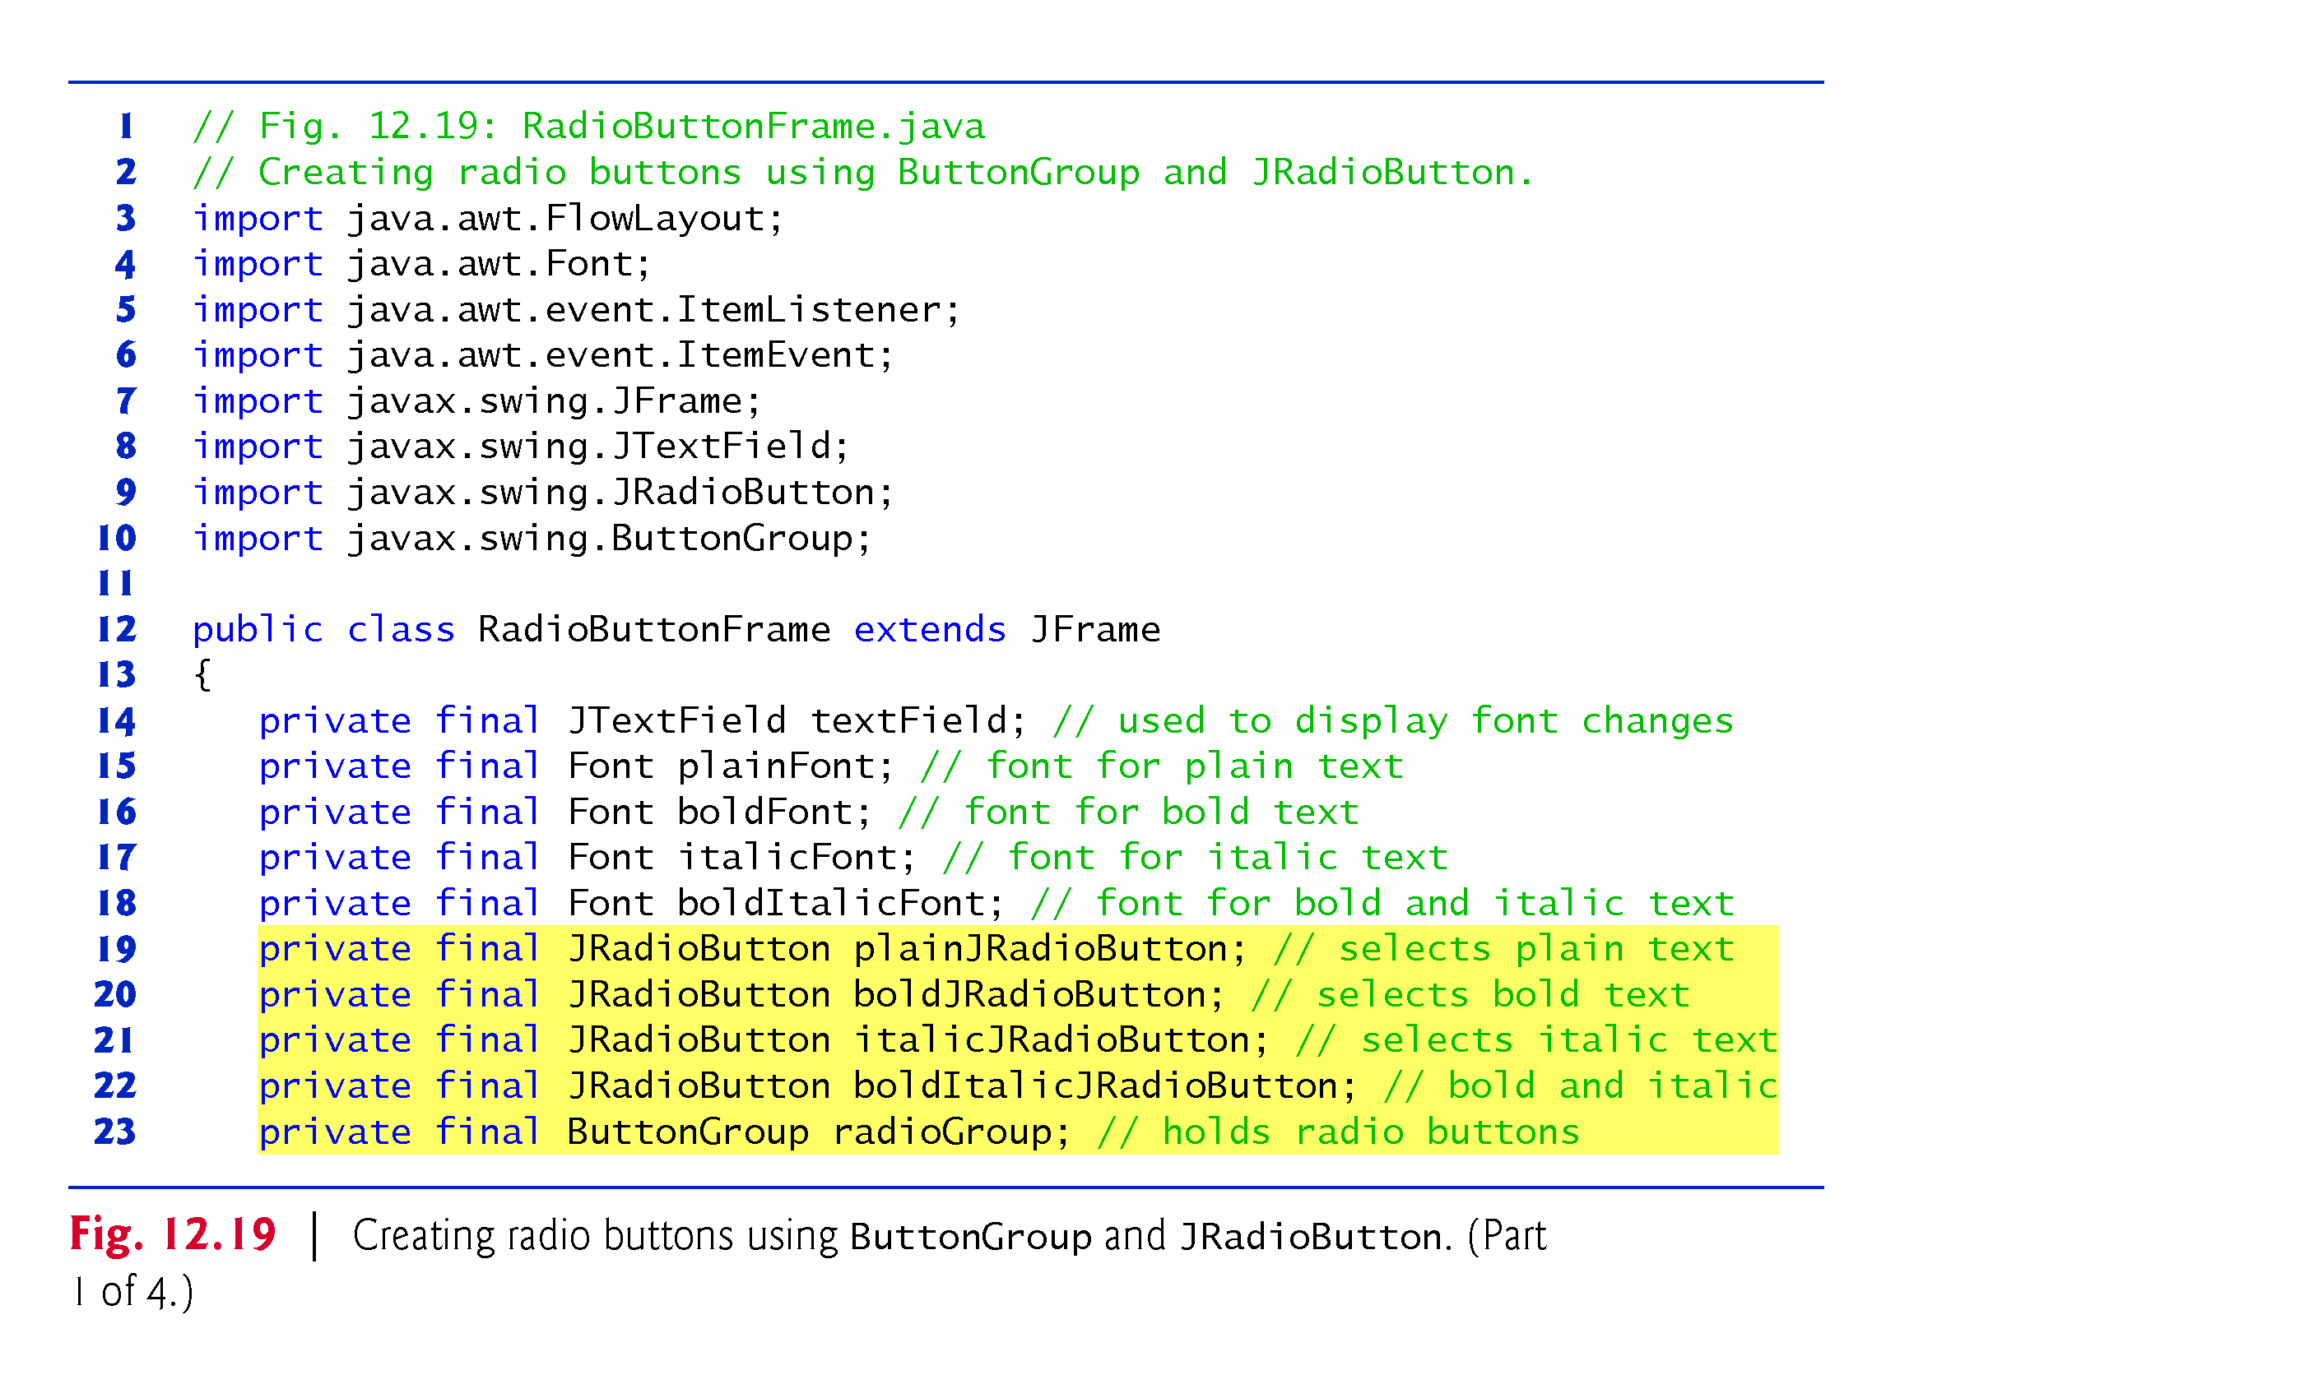
Example 6 : JRadioButton: to change font style of text
Line 5-6: Similar to JCheckBoxes, JRadioButton generates ItemEvent when it is clicked.
Line 10: to group many radio buttons

Slide 28
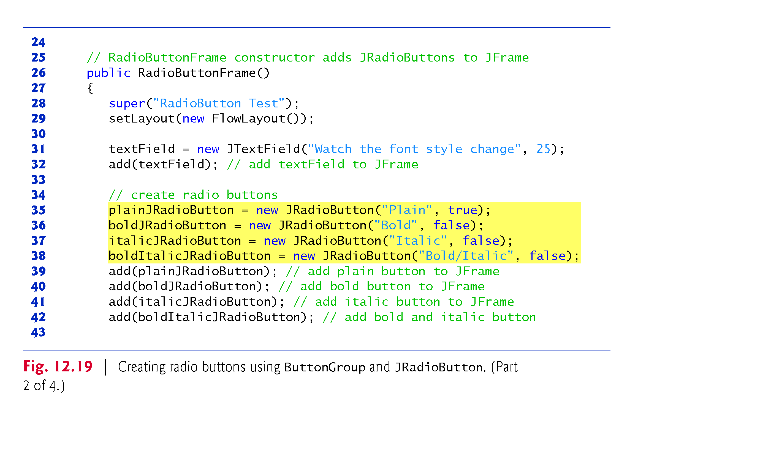
Exam 6 : JRadioButton: to change font style of text con’d

Slide 29
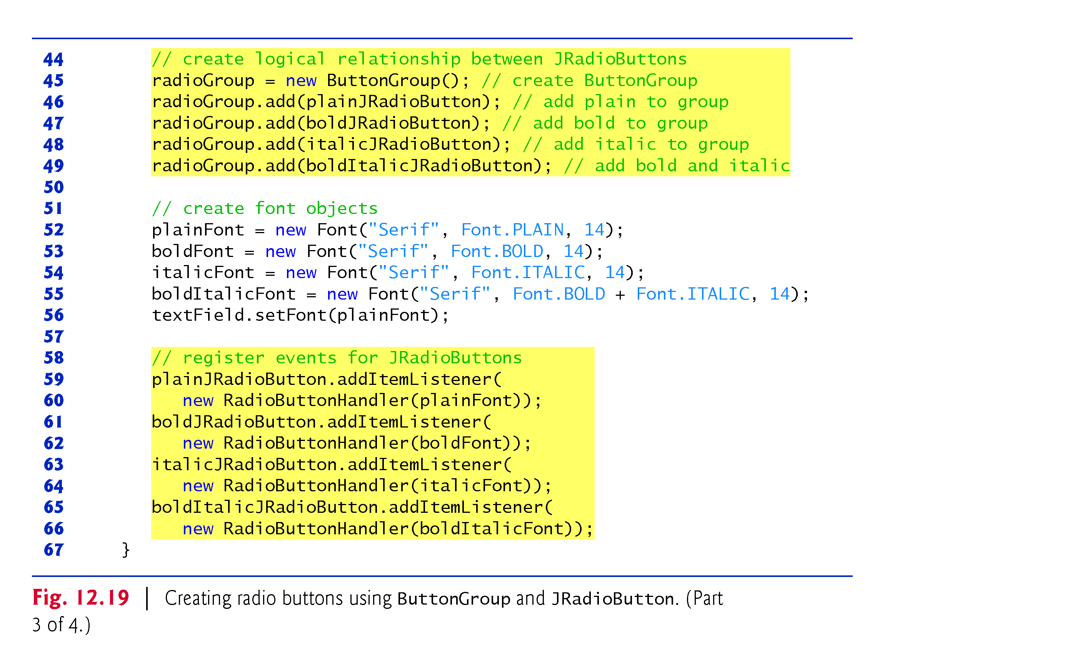
Exam 6 : JRadioButton: to change font style of text con’d

Slide 30
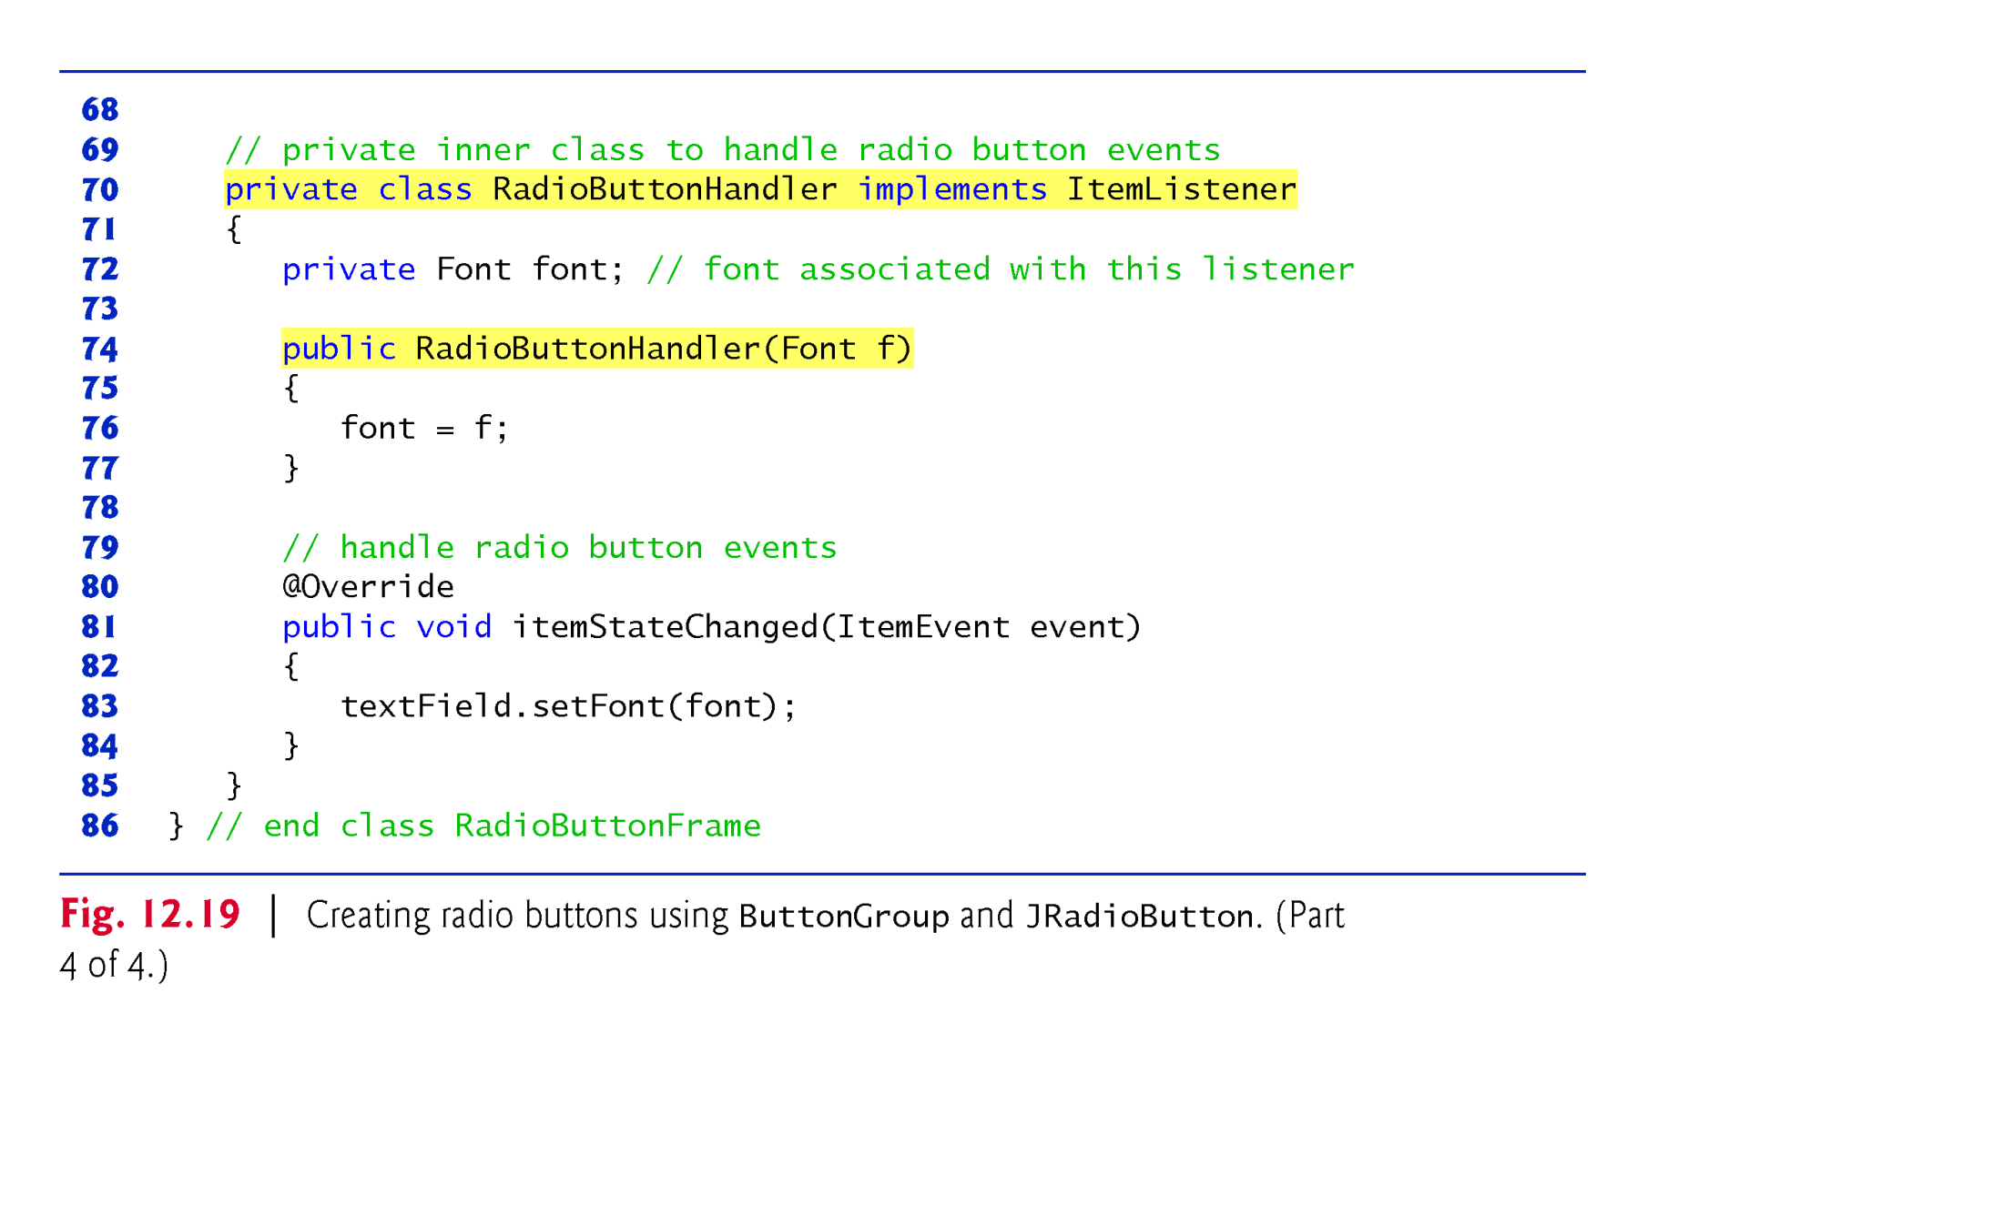
Exam 6 : JRadioButton: to change font style of text con’d
Line 81: This is the only method available in the ItemListner interface (java.awt.event package )

Slide 31
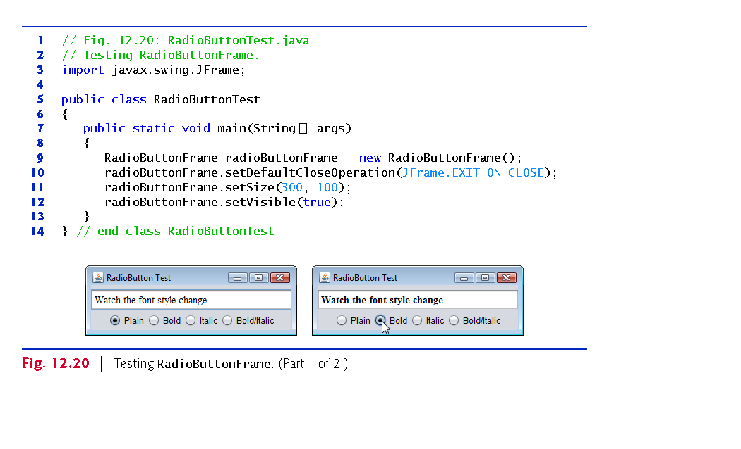
Exam 6 : JRadioButton: to change font style of text con’d

Slide 32
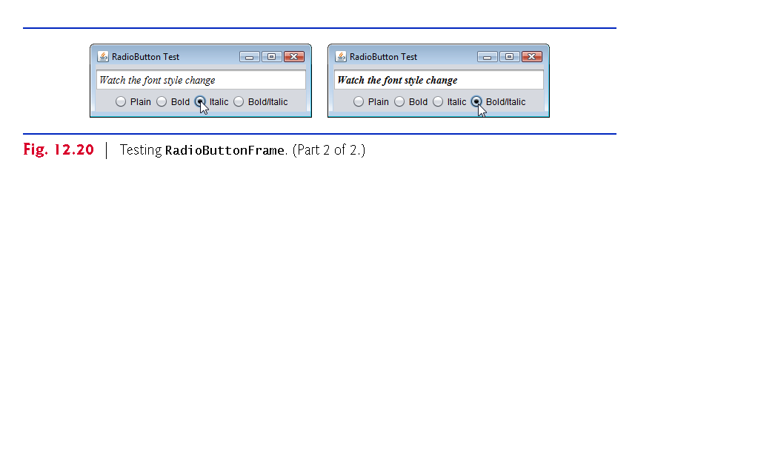
Exam 6 : JRadioButton: to change font style of text con’d

Slide 33
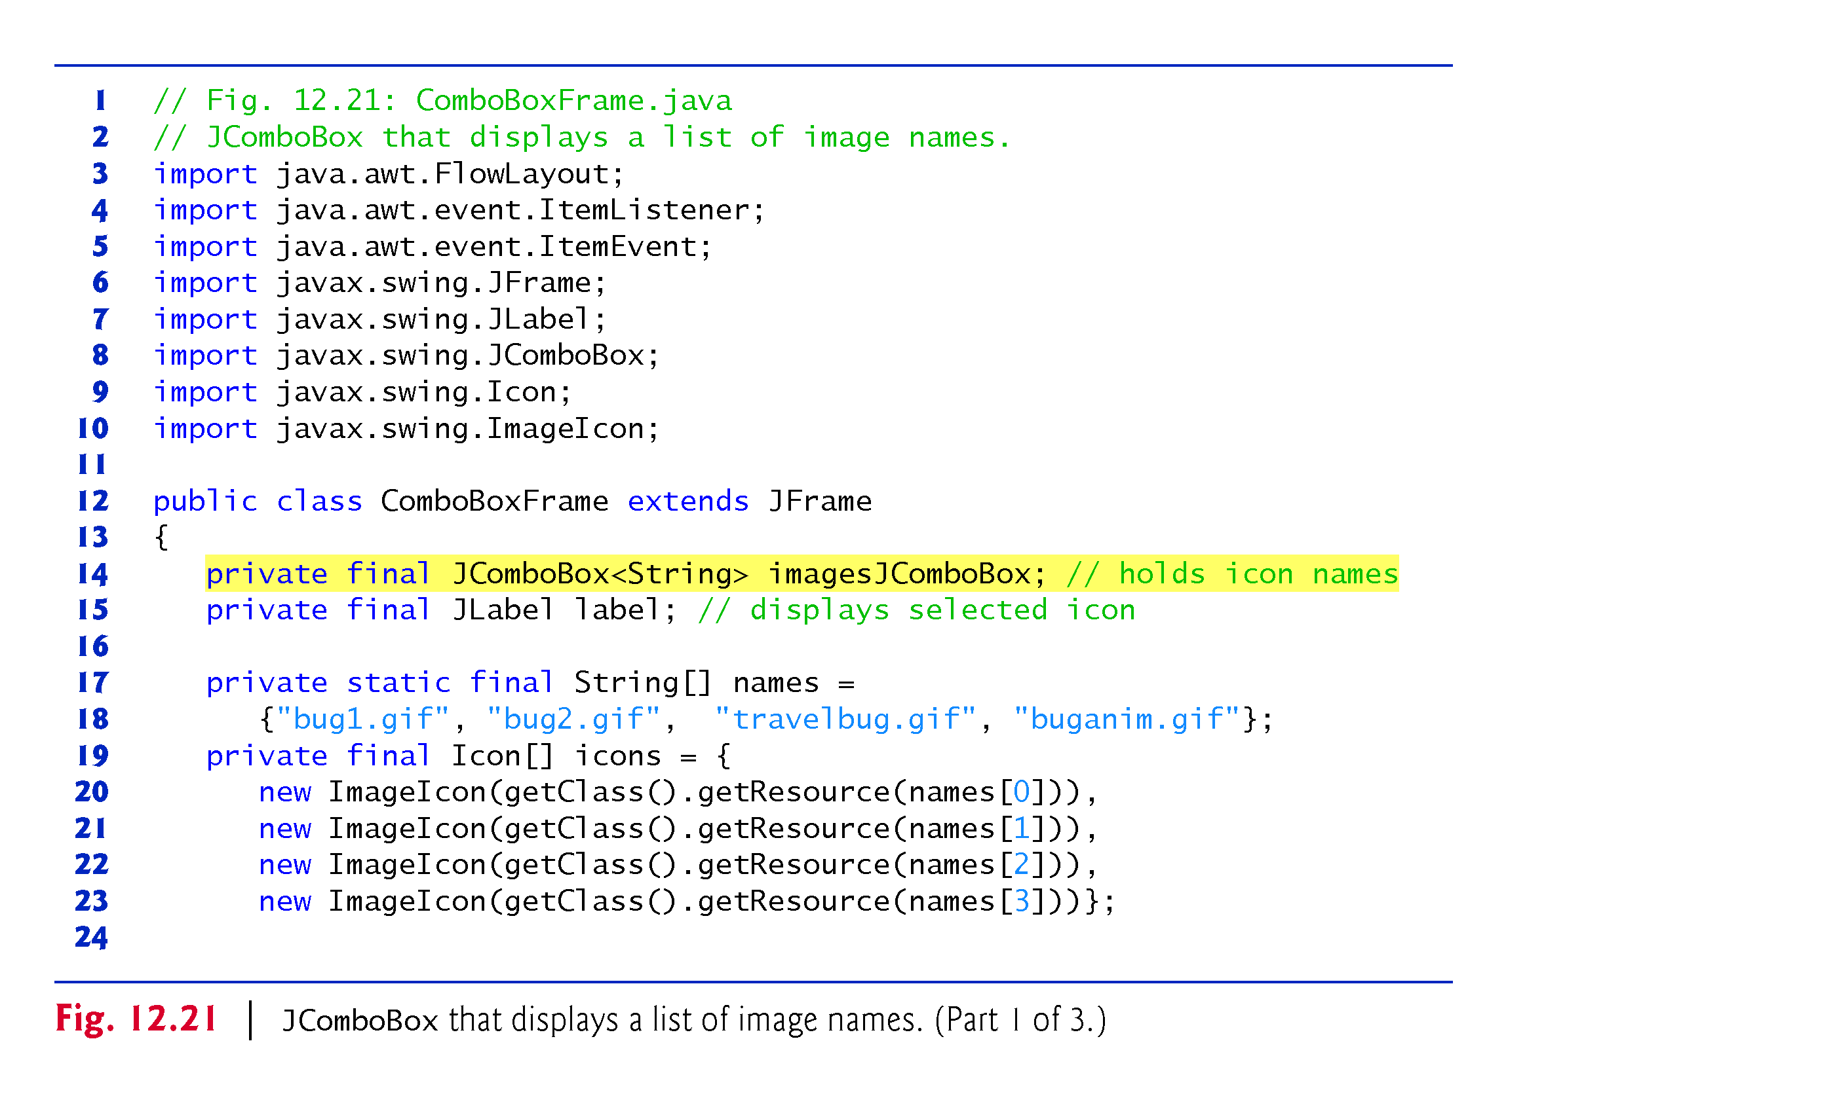
Example 7: JComboBox <>: to displays a list of image names
L14-23: member fields of the class
When user selects file name of an image, the application display the icon of the image on a JLabel
L14-15: GUI components on a JFrame

Slide 34
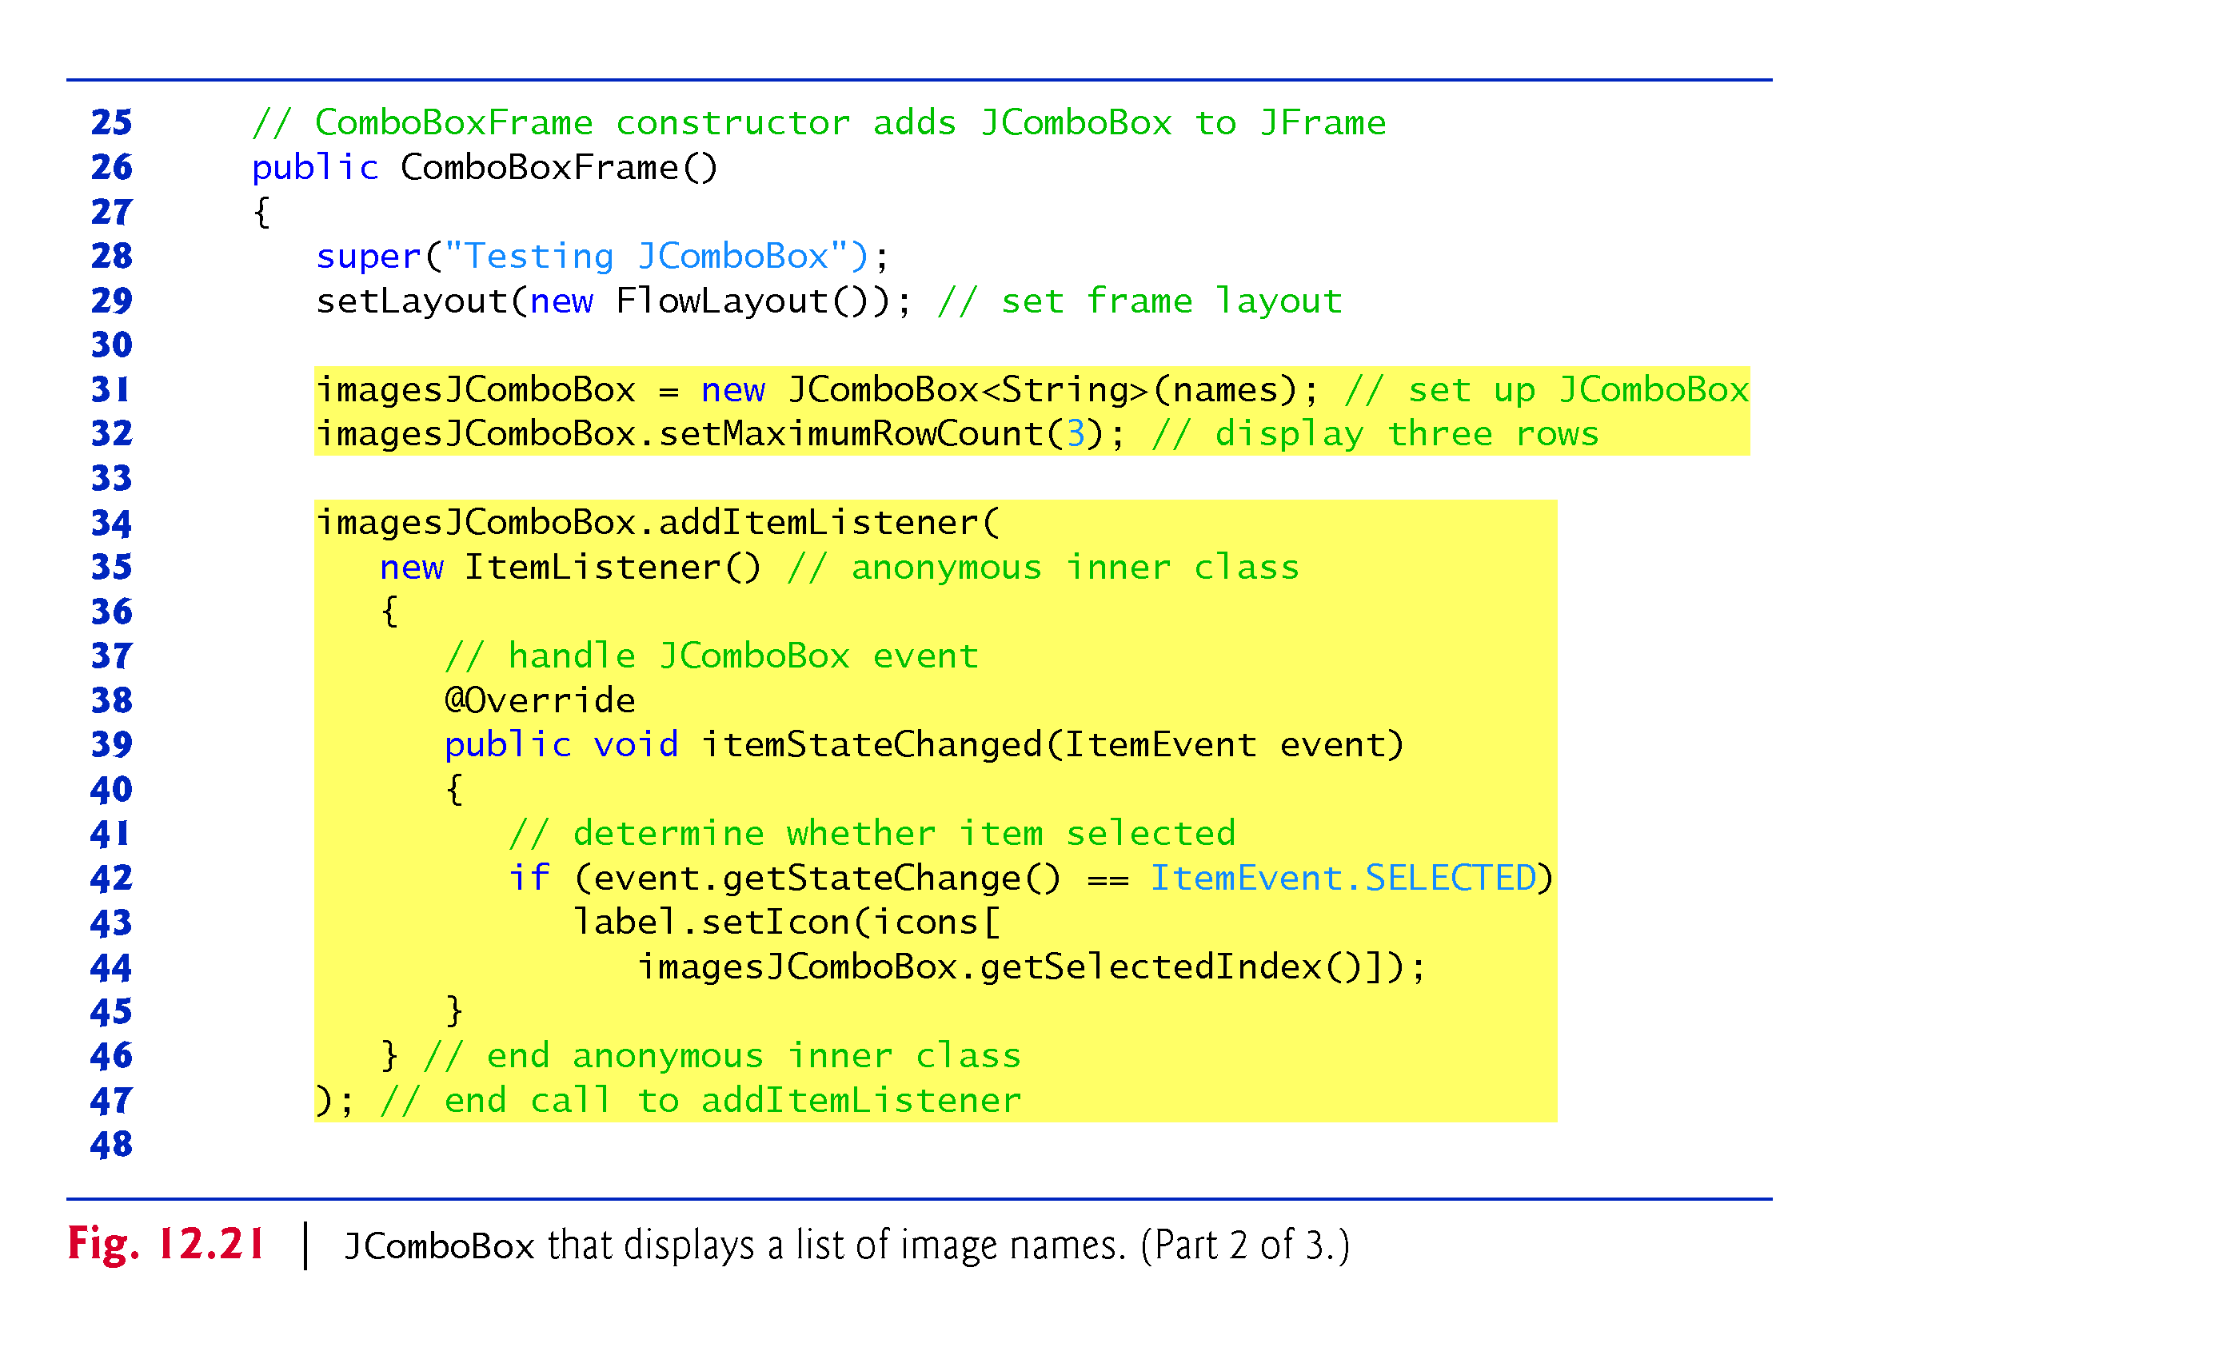
Line 35-36 represent one statement
similar to child class, this statement declares nameless event handler class that implements ItemLisner interface, creates an object of handler class on heap using parent reference, and finally used as argument to register it to the GUI.

Slide 35
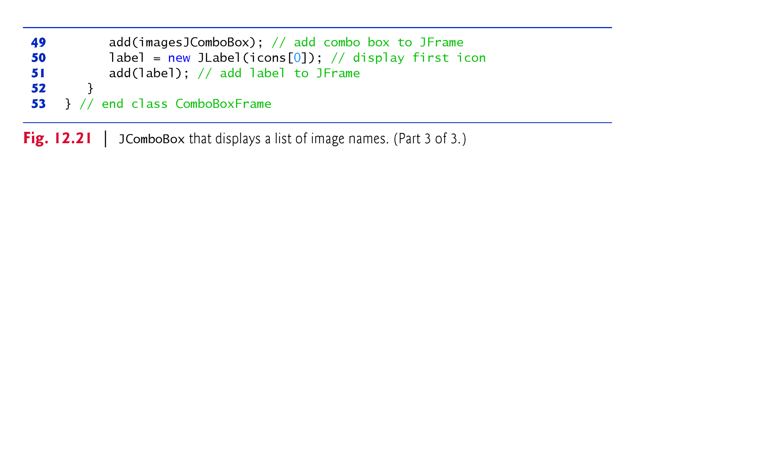
To make more clear:
First, re-write the codes from Line 35-46 as follows and place it at line 33
ItemListner i = new ItemListner () // no semicolon
{
public void ItemStateChaged( ItemEvent event)
{
// body
}
}; // lines 35-36 represent a single statement in java and represents handler class
Second, replace line 34 by the following code
imagesJComBox.addItemListener(i);
i is a reference to an object of an event listener(hander) class which is an instance of nameless inner class.
We can create only one object from the nameless inner class during its declaration.

Slide 36
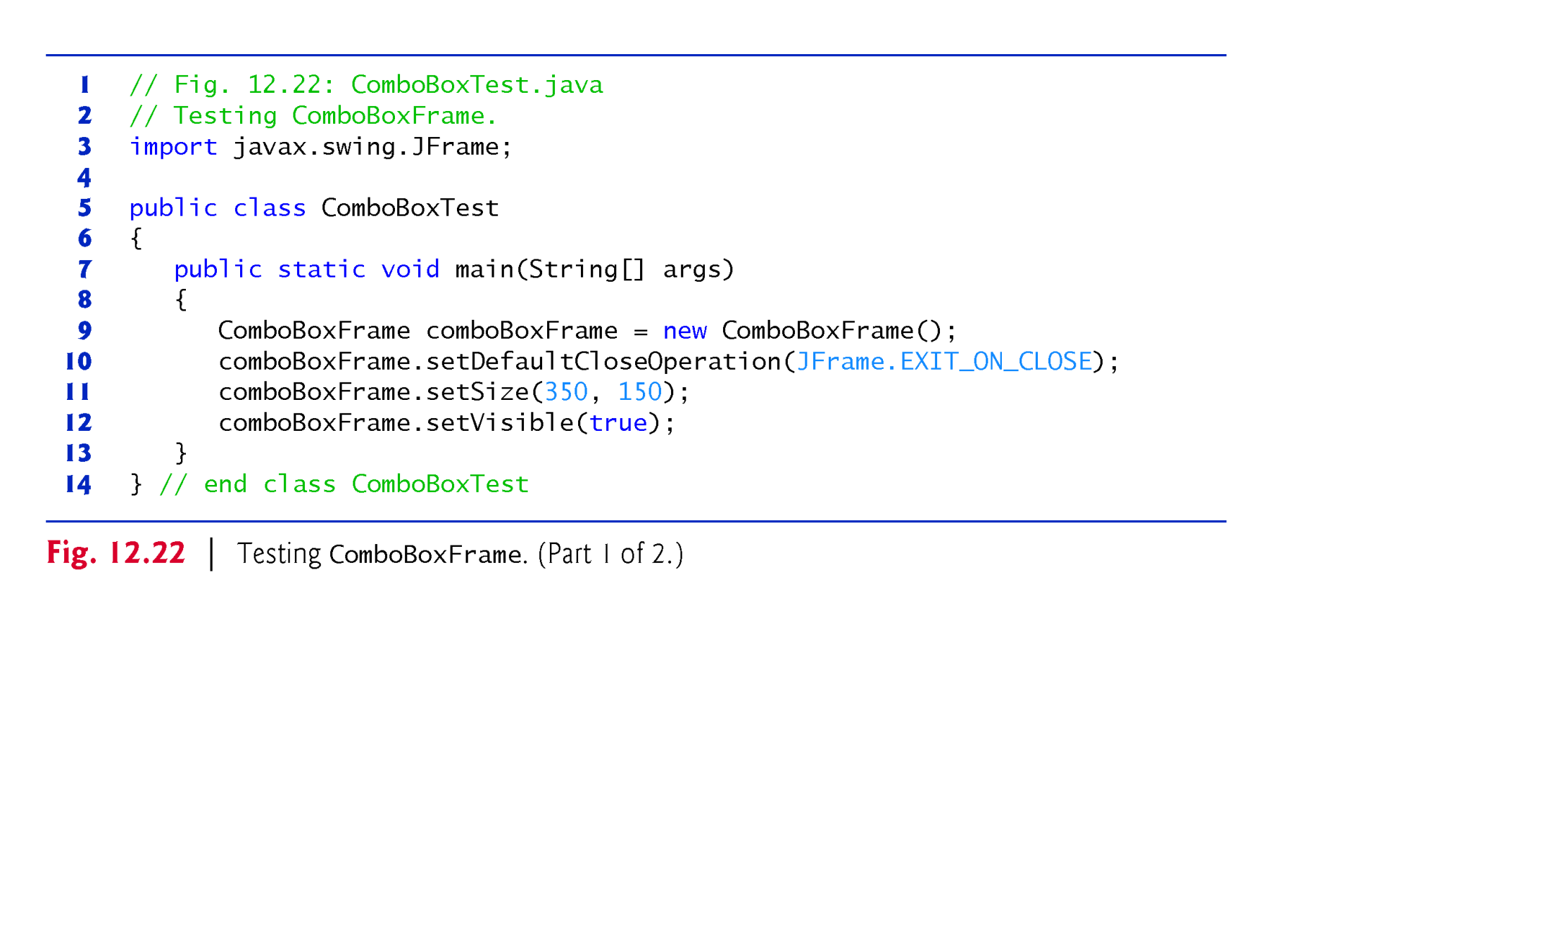

Slide 37
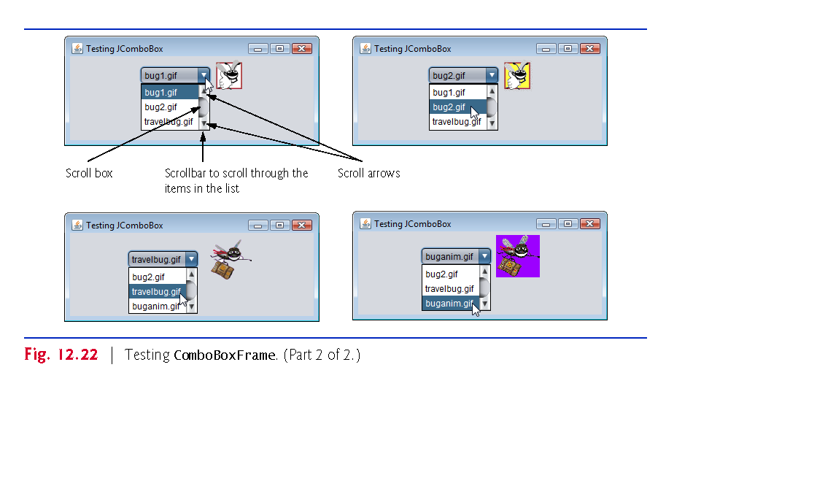

Slide 38
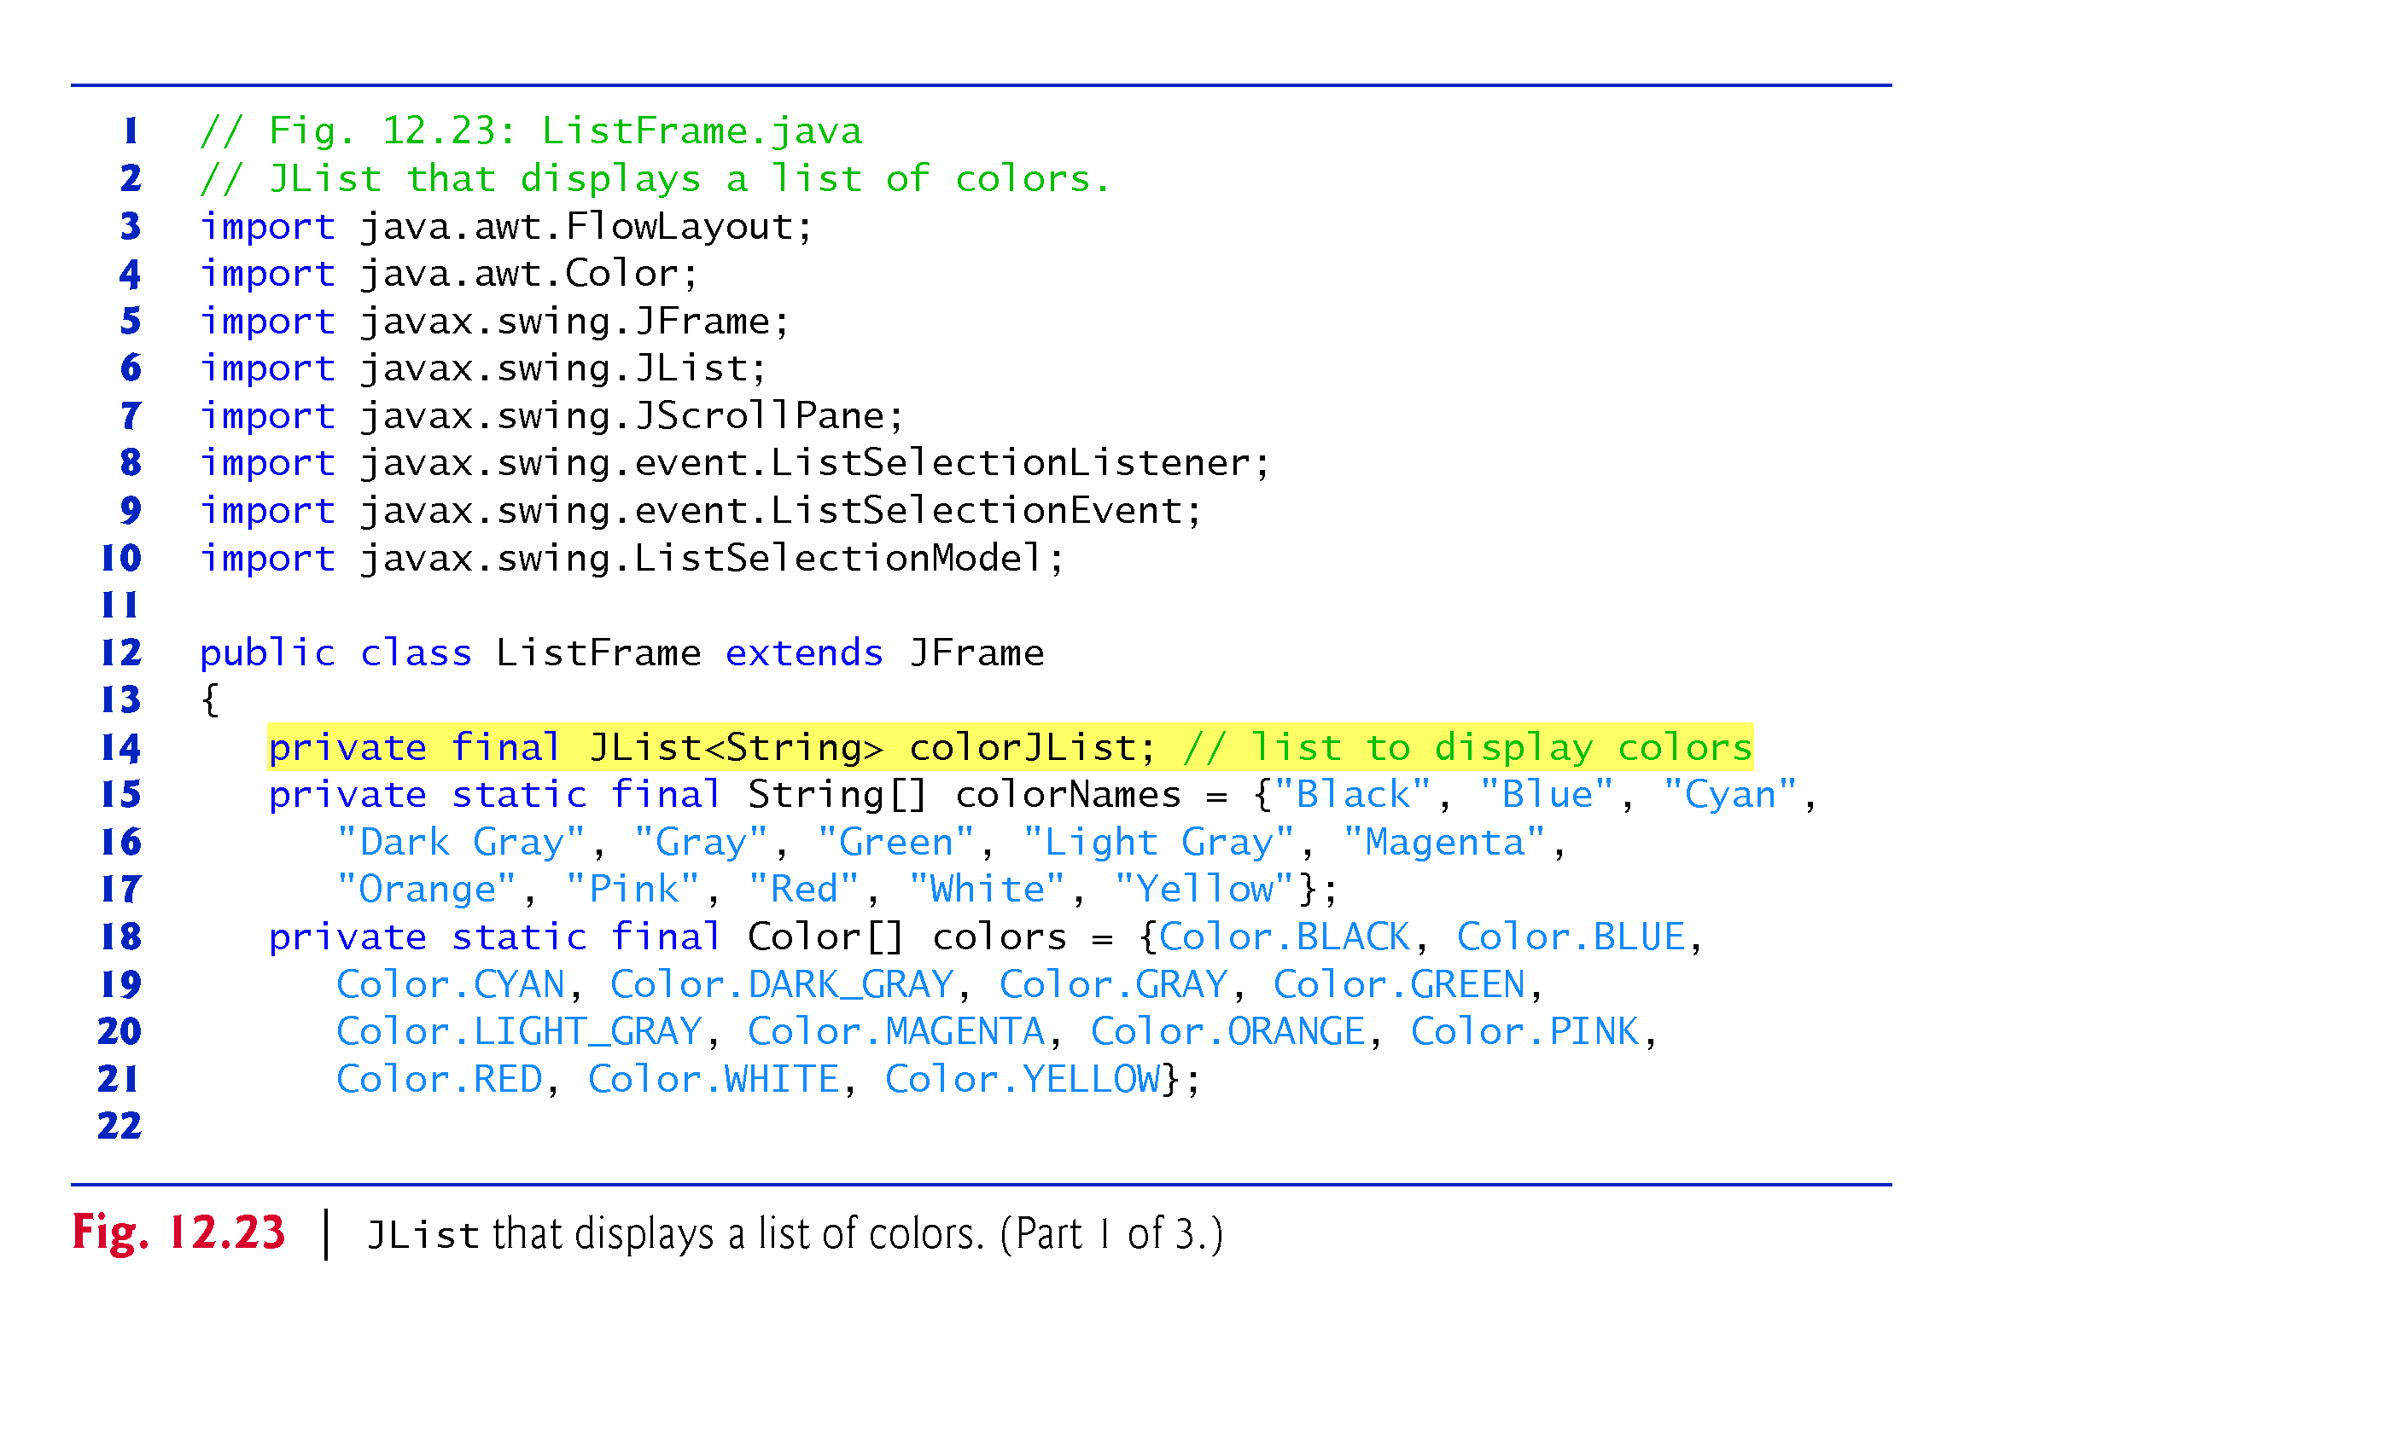
Example 8: JList

Slide 39
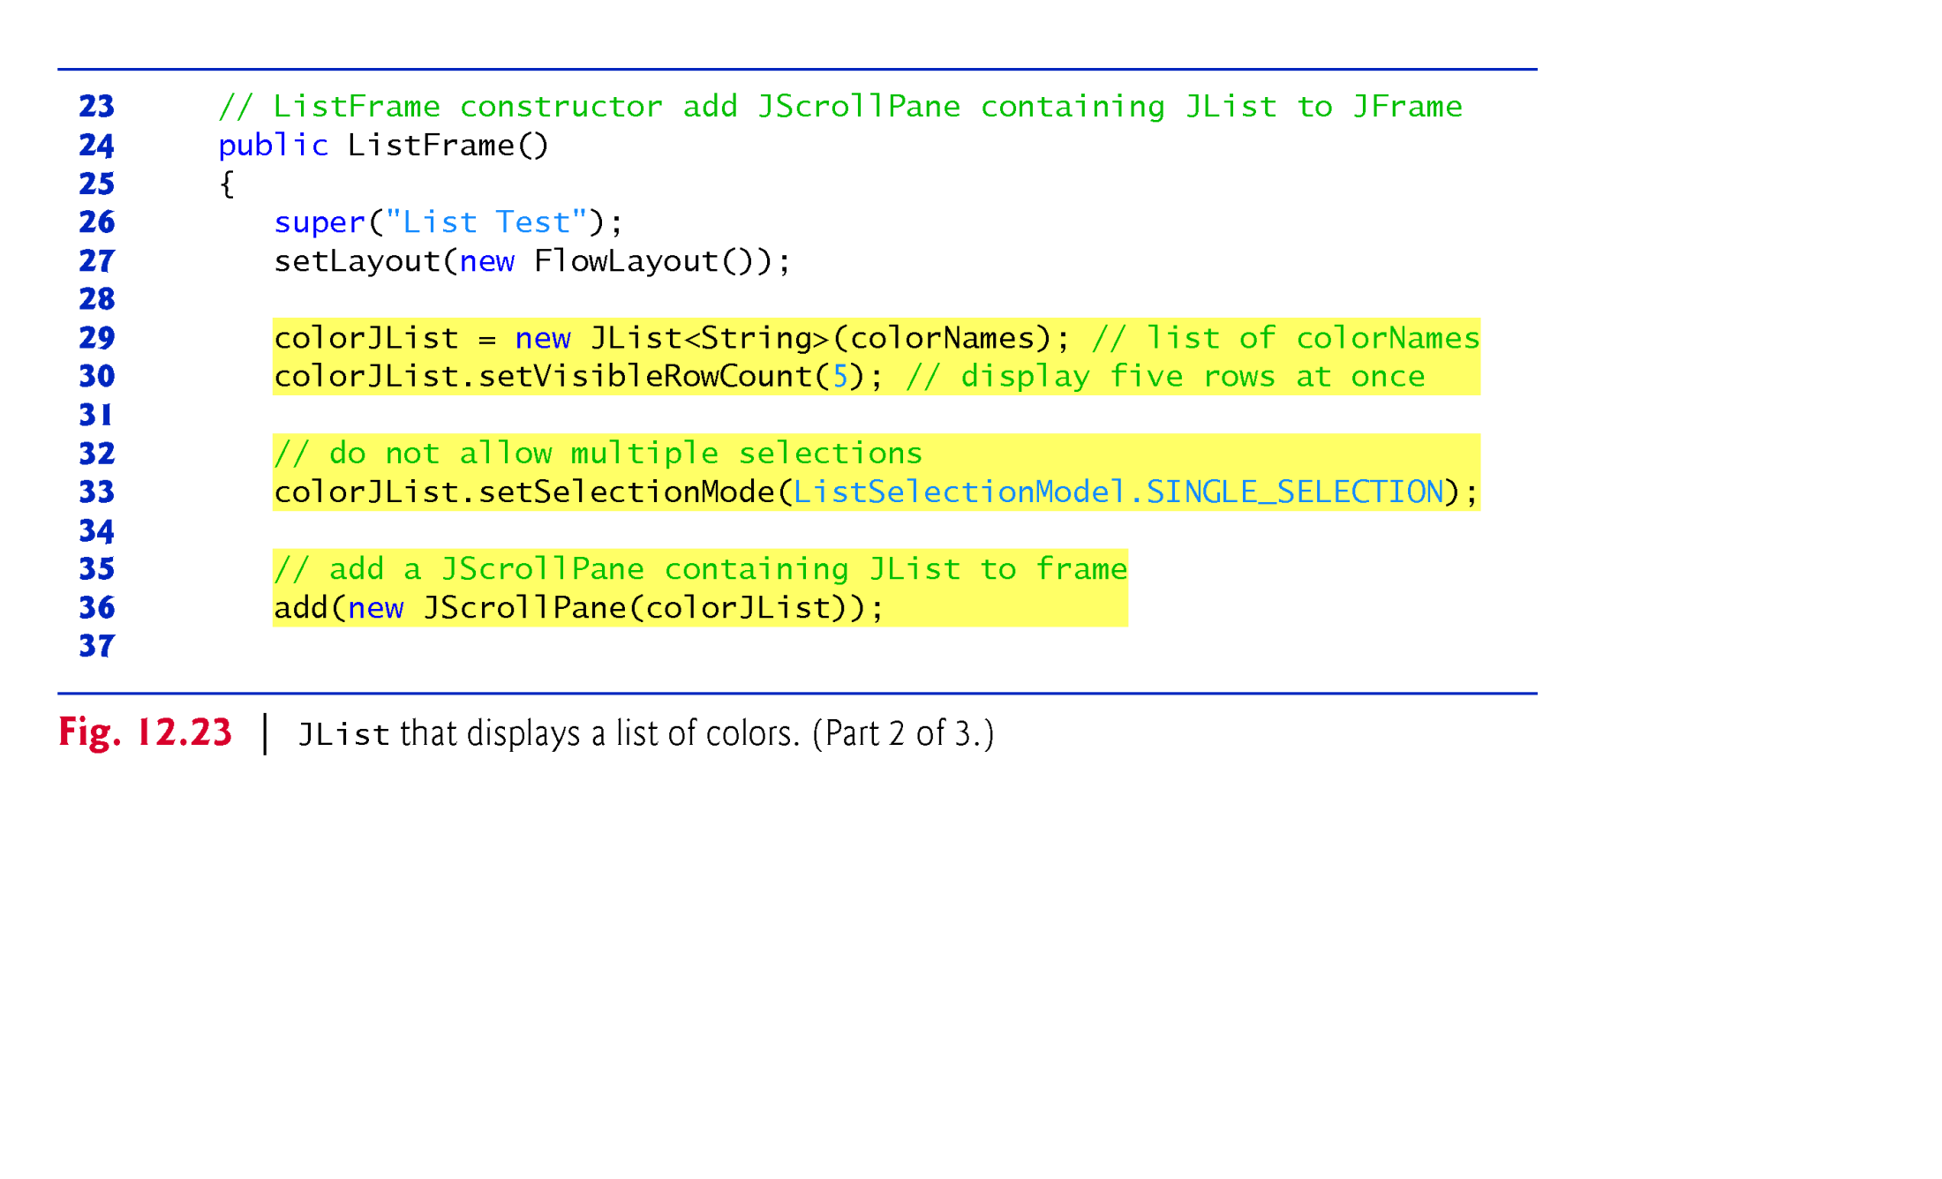

Slide 40
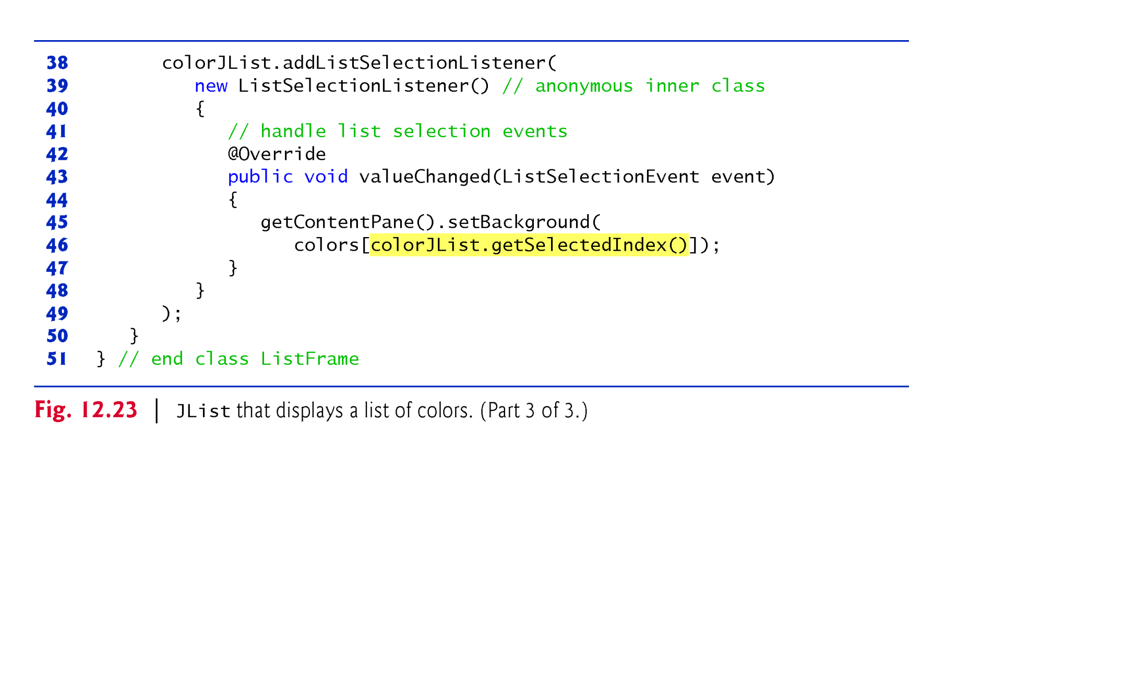

Slide 41
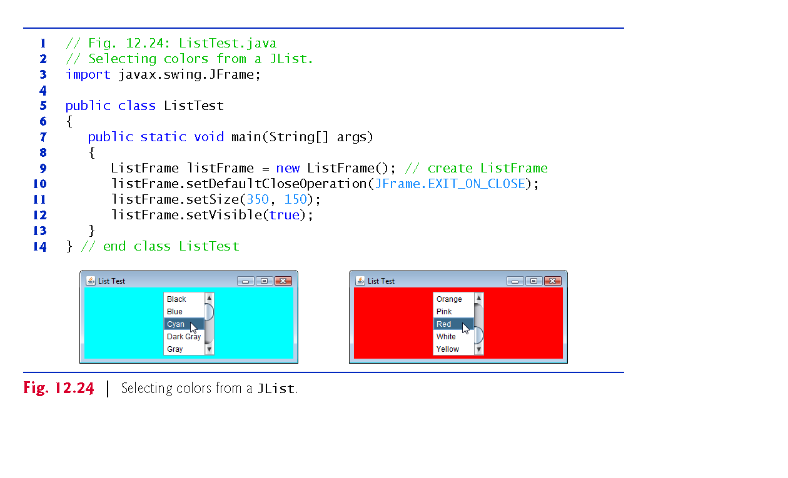

Slide 42
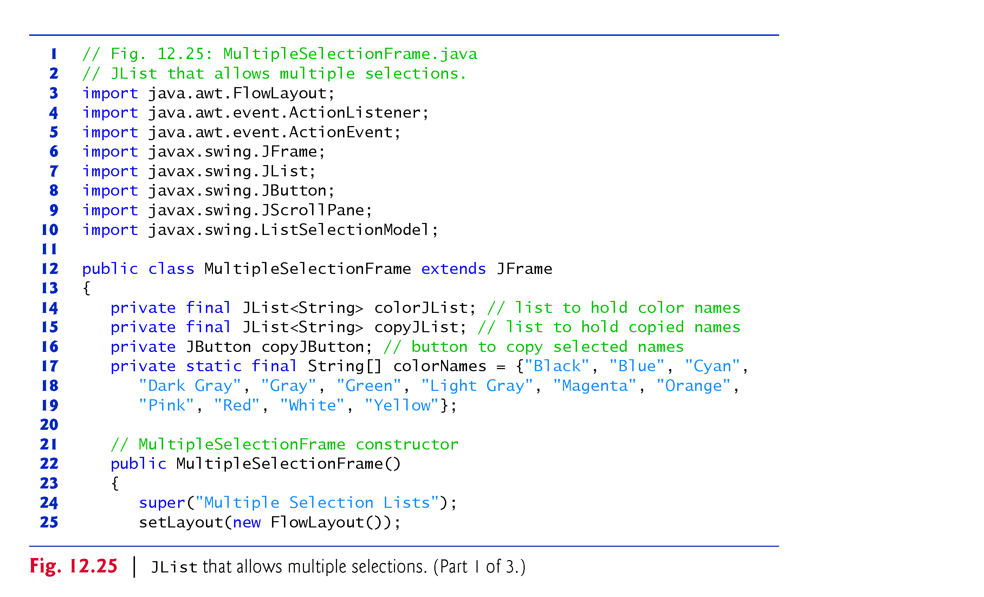
Example 9: List with Multiple-Selection Lists

Slide 43
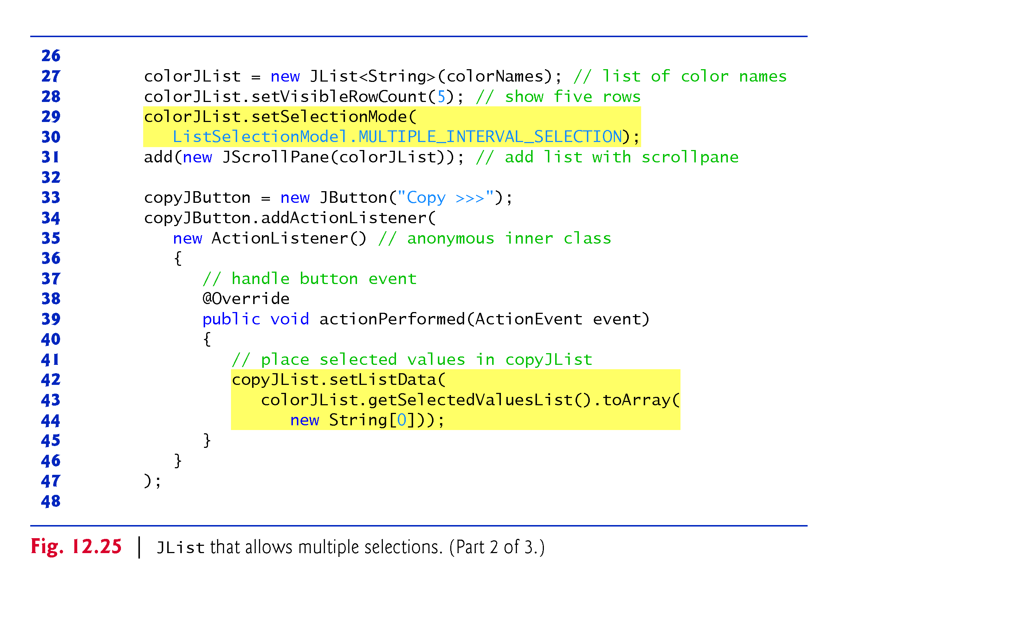

Slide 44
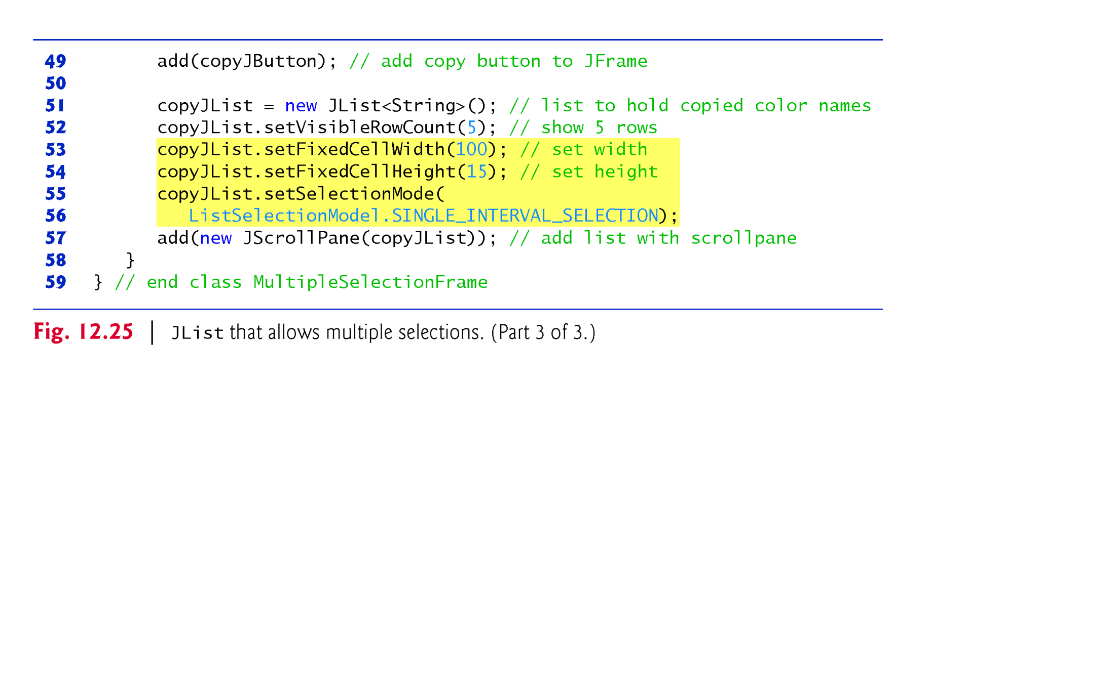

Slide 45
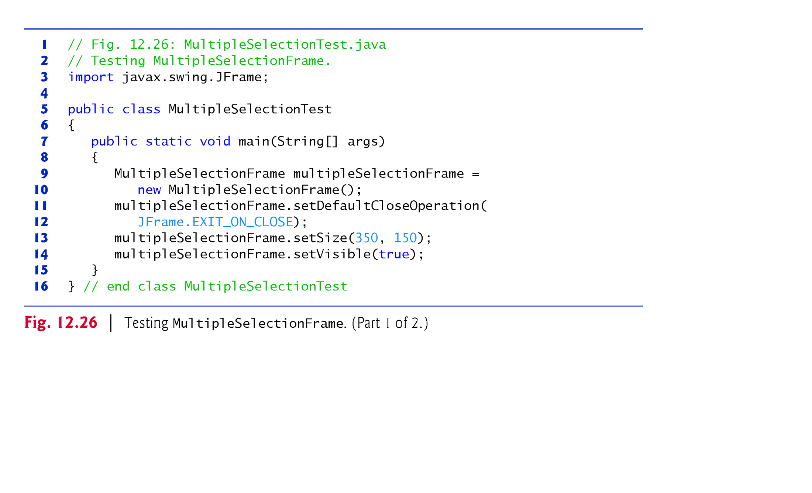

Slide 46
